Slide 1
MR Knowlegde sharing 2015_2
Fred Kunst
LATAM Operations
July 2015

Slide 2
Technical check list in case of IQ problems
Check for latest IQ spec files
Run BodyT batch to check basic system performance
Check Shim and Shim_magnet images for B0 quality (reference to installation images)
Check RF coils, coil accessories, cables and connectors visually (no bends, no damages, protection caps used)
Check suspected RF coil with IQT or CET on both connectors, always visually check all images
Check the Examination room on light bulbs or external equipment (MR approved does not say anything about interference of equipment!)
Check RF door quality and usage of RF door sensor
Check/ask if there have occurred adverse things (e.g. water leakage) or if there have been done any changes lately around the MR system
Run the spurious batch to see if room is clean of interference (spurious) signals, use long earth or mains wire for antenna (4 meters). Image clean does not guaranty that there are no wide band signals present!!
Run Spike sweep batch on QBC and second coil to check for spikes (QPI is not always reliable)
Stability issue (ghosting): Run RX, TX, B0, RF & Gradient stability tests
Run Noise tests, QBC, connector A, connector B, suspected RF coil
Run all RF, Gradient and System calibrations in the correct menu order
Run PIQT to verify results, Trend check of System Head (QA1, 2) and QBC (QA3) on RADAR
Document everything for further support (Viper) etc. in English (use template IQ troubleshoot)
If not clear if it is technical problem consult you local Apps specialist (take DICOM set from system
2
July 2015 South LATAM Operations Confidential

Slide 3
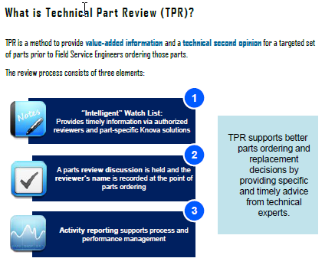
Technical Part Review (1)
9
October 2014 South LATAM Operations Confidential

Slide 4
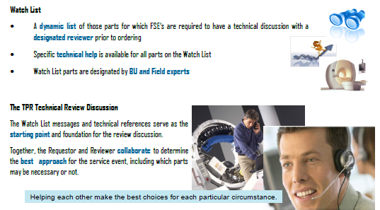
Technical Part Review (2)
10
October 2014 South LATAM Operations Confidential

Slide 5
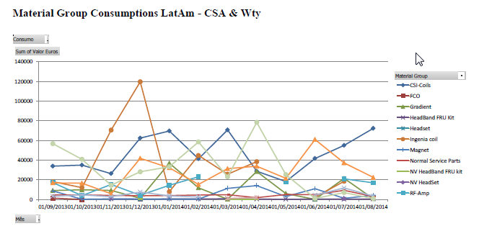
Why TPR?
Objective is to reduce costs on unnecessary HW changes, especially RF coils!
9
October 2014 South LATAM Operations Confidential

Slide 6
CSI project updates
RF Coil Analyzer R5 available
NVC3 coil interchangeability (three LL-FRU’s)
New LL-FRU’s
Update shock indicators
12
October 2014 South LATAM Operations Confidential

Slide 7
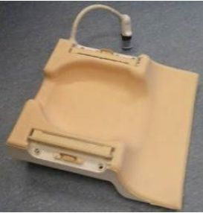
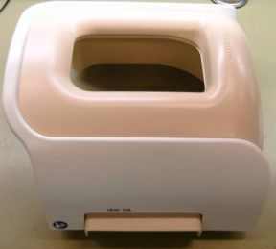
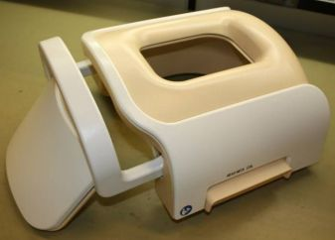
NVC3 coil – three separate FRU’s only for NVC3 (dS Headneckspine)
Instead of complete NVC3 coil, three smaller FRU’s
Base
Head
Headneck
Release in wk35
Ordereable @ SPS in wk36
Diagnostic approach [already supported by RF Coil Analyzer, R5]
Each part is seen by the system as an independent device (“coil”)
SPD is being updated to allow separate part replacement
RF Coil Analyzer is being updated (with R5) to include the new SPD
For IB that has all three parts, identifying the failed part should be easy and with high confidence level
For new installation with only one top: needs to be clear that certainty of correct identification of failed part is not 100% - estimate is 50-60% for electrical/communication problems (Therefore it should be recommended that in uncertain cases both parts are ordered, but only one is opened. Then the other part can be returned as non-open item and be credited).
14
October 2014 South LATAM Operations Confidential

Slide 8
New Low level FRU´s
Achieva 32ch Head coil cable
Knee Plunger (handle)
Knee Plunger (top-bottom)
Ingenia 3T TR Knee cable (Rx)
Ingenia1.5T 16ch Knee cable
Ingenia 8ch Knee cable
Ingenia Small Extremity cable
15
October 2014 South LATAM Operations Confidential

Slide 9
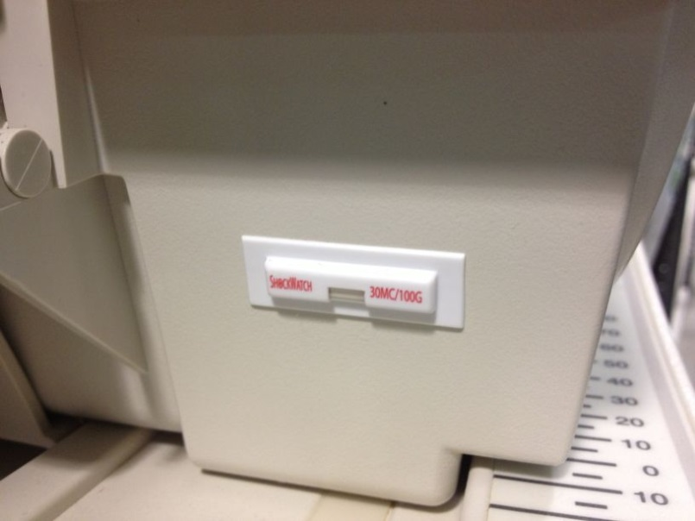
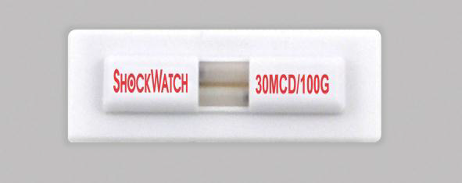
Update shock indicators
Pilot in France completed successfully (8 sites, ~60 coils)
In Chile installed on new sites only
Document released, describing mounting recommendations
Implementing global deployment
Method of deployment: communication with direct ordering information, application guidelines, customer communication guidelines.
16
October 2014 South LATAM Operations Confidential

Slide 10
Coil improvement - completed
Coil | Platform | Issue /Problem | Corrective Action | Status
32ch Head | Achieva (Ingenia coil has these improvements from release) | Flex PCB Connectors (spikes). | New Flex PCB New connectors (SMP) | implemented (.3/.4) mid 2012 Implemented (.5) 4/13
8/16ch NVA | Achieva | Loose Contacts Coax pin in cable assembly Superior latch | Secure by Loctite 100% incoming inspection Redesign | Implemented 3/13 Implemented 3/13 Implemented 1/14
15ch Spine | Achieva | Cracking in capacitor solder joint Semi-rigid cable soldering Solder joint detune PCB | Changed to leaded capacitors. Process changed Change soldering method | Implemented 4/13 Implemented 2/13 Implemented 9/13
Multiple coil types (NVA, Shoulder, Cardiac, Spine, Knee, and more) | Ingenia & Achieva | MMCX connector discontents | Add retainer clip | Implemented in forward production and repairs 7/13
12
October 2014 South LATAM Operations Confidential

Slide 11
Coil improvements - completed
Coil | Platform | Issue /Problem | Corrective Action | Status
3T 16ch TR Knee | Ingenia & Achieva | Pick Up probe discontent | Retainer clip in ODU connector | Implemented in forward production and repairs 7/13 Communication to the field for local repair completed
Foot-Ankle | Ingenia | Inductor failure System cable (hose breaking) | Assembly process corrected Longer cable | Implemented 2/13 Implemented 10/13
Knee (all types, 8/16ch, Rx/TR) | Ingenia & Achieva | Cable assembly (broken wires and shield) | Cable construction corrected | Implemented
Ingenia 8ch Shoulder | Ingenia | Disconnect of anterior part IQ Complaints | Longer contact pins Protocol optimization | Implemented Improved protocols developed and released in NetForum Felix filtering improvement in process
NVC (1&3) | Ingenia | Top cover cracks | Molding process improved FRU cover kits to enable field replacement for IB. | Implemented in 1/14 FRU released
13
October 2014 South LATAM Operations Confidential

Slide 12
Coil improvements - completed
Coil | Platform | Issue /Problem | Corrective Action | Status
NVC3 | Ingenia | Pad is caught between coil parts and prevents latching Diode failure (1.5T) due to component defects Loss of communication due to internal cables issues Side screws breakage | Pad redesigned Added and Improved testing at diode supplier Process improvements at cable assembly supplier Change assembly instruction. Add FRU | New pad implemented in June 14. Implemented 11/13 Implemented. Assembly process changed. Part available in CSI Kit #2
Torso XL | Achieva | Flex PCB Cables | Torso XL 2.0 | Released
14
October 2014 South LATAM Operations Confidential

Slide 13
Coil improvements – In progress
Coil | Platform | Issue /Problem | Corrective Action | Status
Multiple coil types (NVA, Shoulder, Cardiac, Spine, Knee, and more) | Ingenia & Achieva | MMCX connector discontents | Change to SMP connector | Implementation starts Sep 13 with plan according to material availability and priority list.
Multiple coil types (Cardiac, all Ingenia coils) | Ingenia | Cable assembly hoses | Change hose material and internal construction | Tooling completed. Implementation planned Q3-14
Multiple coil types | Ingenia & Achieva | Bazooka balun fails (cracked solder joint) | Balun redesigned | Solution is In final verification testing and procurement. Implementation in Q3-14
HRH | Achieva | Cable Assy Friction lock Preamp | New cable assembly Improvement implemented | Cable testing in process
Flex coils | Ingenia | DC trace breaking | PCB redesign | In process - implementation Q3.
15
October 2014 South LATAM Operations Confidential

Slide 14
Coil improvements – In progress
Coil | Platform | Issue /Problem | Corrective Action | Status
NVC1 | Ingenia | Preamp failure due to ESD | Added ESD protection in CEB’s | Implementation in repairs in Q3-14
NVC3 | Ingenia | Inductor disconnect Replacement of separate parts | CEB Support change Separate FRU’s (interchangeability) | In implementation . In final logistics process. Availability 8/14.
32ch Head | Ingenia | Various assembly/workmanship issues | Added testing in final coil level | In implementation
Head | Multiva/ Omniva | Cable assembly | PCB redesign | Implemented FCO released and in in deployment
Spine | Multiva/ Omniva | Preamp disconnection (PCB assembly error at supplier) | Error corrected. Additional secure hardware added | Completed
Torso | Multiva/ Omniva | Cable-PCB stress | Change cable fixation | In implementation.
dStream Interface | Ingenia | Multiple issues | Complete redesign | Released planned for 09/14
16
October 2014 South LATAM Operations Confidential

Slide 15
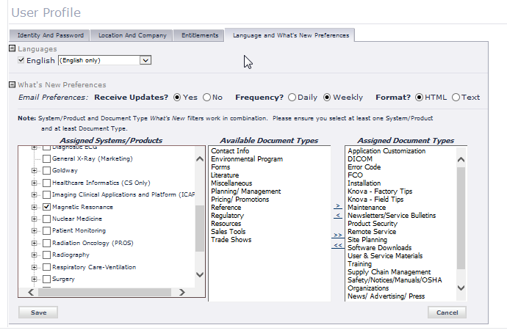
InCenter updates – User Profile
5
October 2014 South LATAM Operations Confidential

Slide 16
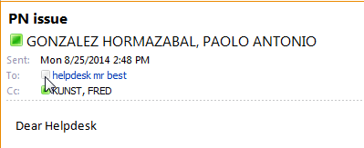
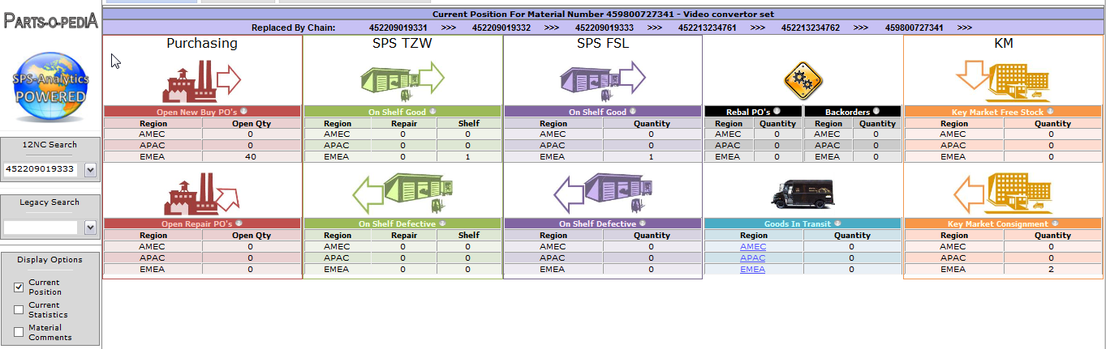
MR Helpdesk communication
Only MR helpdesk communication via OneEMS or Clarify cases !!
The MR helpdesk mail box is since many years not read.
http://pww.sps.cle.ms.philips.com/Parts-O-Pedia/
7
October 2014 South LATAM Operations Confidential

Slide 17
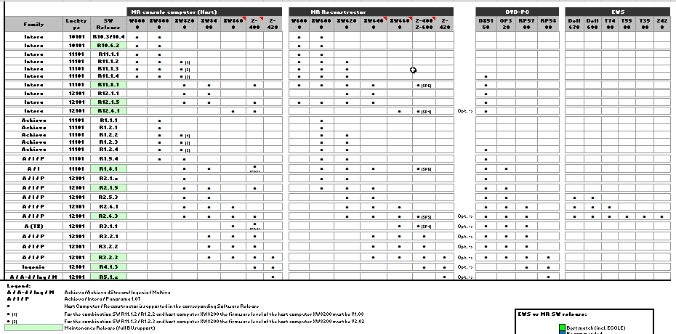
Software - computer matrix
5
October 2014 South LATAM Operations Confidential

Slide 18
Maintenance SW Release overview
Security Fixes:
Security Fix May 2014 MR: R12.6.1, R2.6.3, R3.2.3, R4.1.3, EWS R2.6.3
BDAS maintenance releases:
MR R10.6.2 / R11.1.4: SP6
MR R11.8.1 / R12.1.5: SP6
MR R12.6.1: SP4
CDAS maintance releases:
MR R1.5.4: SP9
MR R1.8.1 / R2.1.5: SP6
MR R2.6.3: SP9 Intera, Achieva, Panorama HFO
MR R3.2.3 SP2 Intera, Achieva, Panorama HFO
MR R4.1.3 SP3 R4 is for Ingenia only
MR R5.1.2 initial release with support of AIBO, Multiva
MR R5.1.7 SP2 initial and FCO for R5.1.2 with support LCC2B, WCRF
MR R5.1.9 DDAS on Ingenia systems + PSC + Health viewer
Extended MR Workspace releases:
EWS R2.6.3 SP5,
EWS workstation fade out Q3-2014, replaced by ISP workstation, MMod, M-Vendor
6
October 2014 South LATAM Operations Confidential

Slide 19
Software Planning: (NPI)
R5.1.8 Multi Nuclei on Ingenia
R5.1.8 Ingenia CX, with ZBO 1.5T magnet (bore 60 cm), dstream patient support
R3.2.10/R5.1.10 DDAS on Achieva systems
R5.2.0 Ingenia 1.5T (S) , Ingenia CX , Achieva 1.5T
Host/Recon into DACC
ConforTone
AutoVoice
DICOM selfservice module
EC editor and EC install tool
7
October 2014 South LATAM Operations Confidential

Slide 20
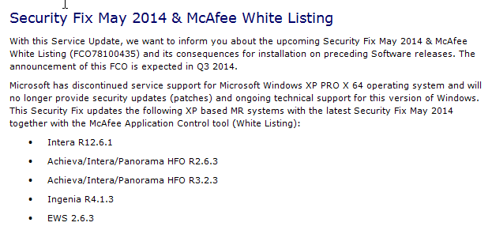
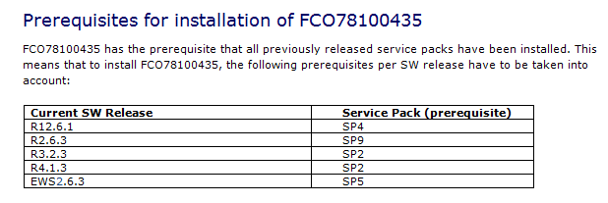
Security Fix 2014
12
October 2014 South LATAM Operations Confidential

Slide 21
FCO efficiency RS Installations
See procedure of Fred

Slide 22
DDAS info
See PDF document
23
October 2014 South LATAM Operations Confidential

Slide 23
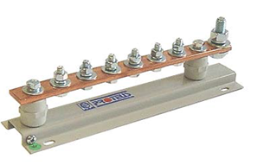
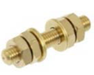
PRD update w.r.t Protective Earth
Dear colleagues, this new information has recently become available in the PRD Multiva, chapter 8.3. Protective earth.
It is also valid for other configurations, but because of timing issues between various service documents and BOM, it is not yet visible in the PRD´s of Achieva and Ingenia. But the scheme is valid for ALL configuration. With the new system delivery it could be that not all delivered PE cables have the correct length and labels but I recommend to implement this new PE scheme asap.
Installation Project Managers: Please inform the Hospital project managers and the RF cage suppliers about these changes in the Philips requirements.
RF cage earth point: PE bus-bar:
14
October 2014 South LATAM Operations Confidential

Slide 24
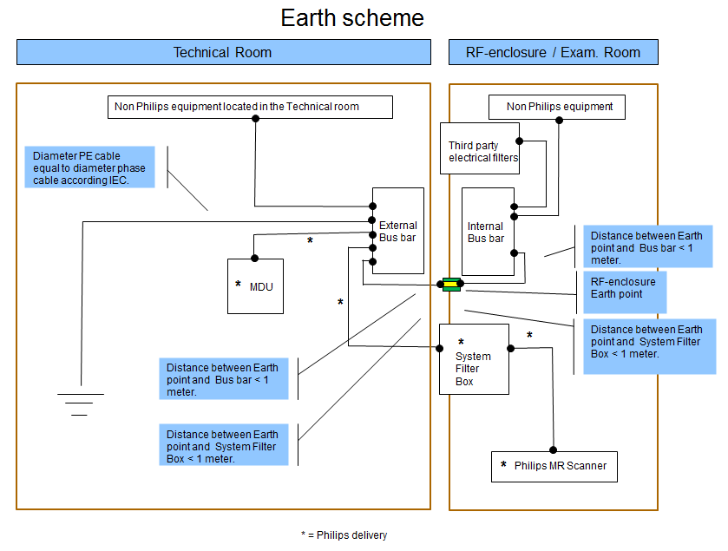
Protective Earth MR system
Independent ground line just for MR equipment (no other interconnections allowed)
At least same diameter as incoming phase wires
Origin connected to central hospital PE ground
RF cage must be grounded during installation to hospital (tech room) PE bus-bar
Insulated ground line

Slide 25
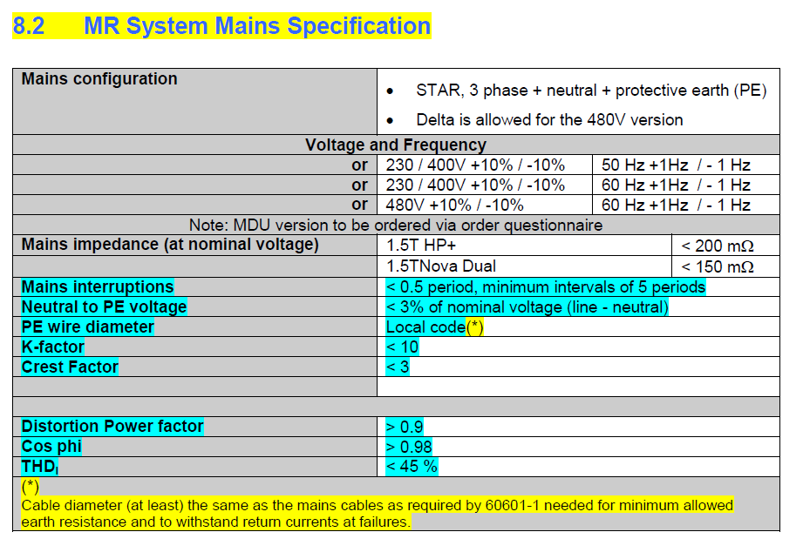

Slide 26
Incoming Power MR system
Terra Neutral -Separate power system (T and N make inter connection inside Transformer)
Diameter of incoming line depends on the distance to Transformer!
Between 0 and 30 m: 50 mm2
Between 30 and 61 m: 70 mm2
Between 61 and 92 m: 95 mm2
Mains circuit breaker 100 Amps or 125 Amps (dual gradients).
Hospital power/earth connections to gMDU are not part of Philips delivery and must be done by local electrician according local standards
Power configurations g-MDU
Frequency 50 Hz
Input 400V-50Hz gMDU comes without transformer to work with 400V and 50Hz for all cabinets
LCC delivered is only working with 400V-50 Hz
Frequency 60 Hz: Two gMDU configurations are possible:
Input 480V-60Hz comes with transformer to down transform to 400V- 60Hz for all cabinets except LCC and Gradient amp
Input 400V-60Hz comes with transformer to up transform into 480V-60Hz for LCC only
LCC delivered is working only with 480V-60Hz
Gradient cabinets work with range 380-480V and 50/60Hz

Slide 27
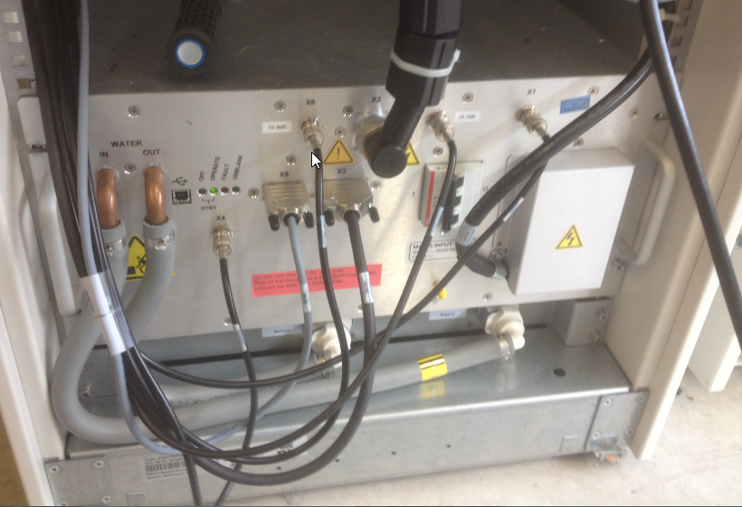
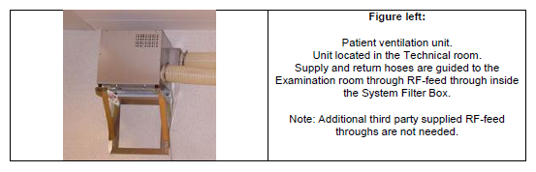
PRD changes
Water Cooled RF amplifier:
PVU not delivered anymore:
Integrated in SFB
21
October 2014 South LATAM Operations Confidential

Slide 28
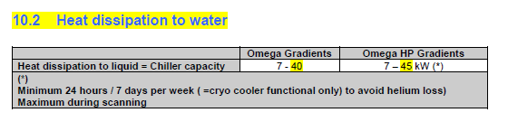
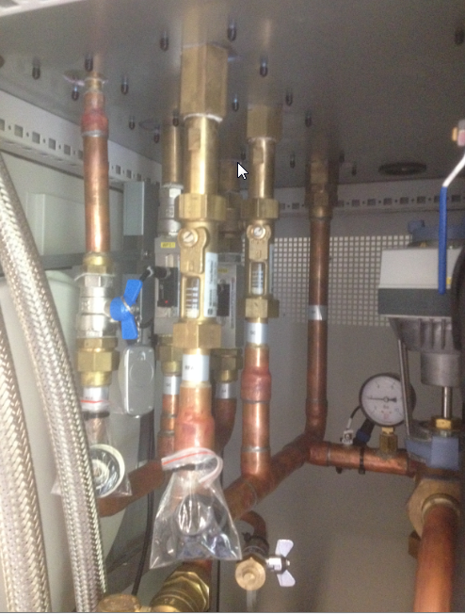
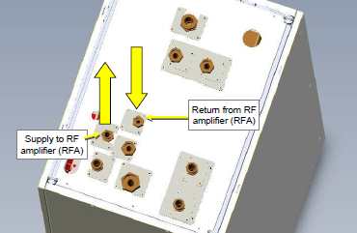
PRD changes
Chiller capacity requirement is slightly higher:
LCC2B for WCRF:
20
October 2014 South LATAM Operations Confidential

Slide 29
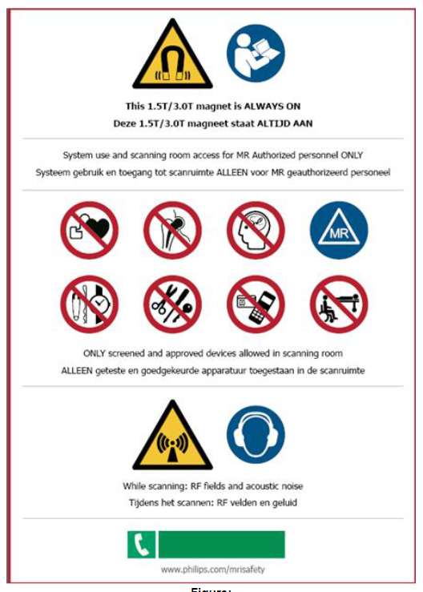
New Safety marking sheet with new R5 systems
CE compliant
8
October 2014 South LATAM Operations Confidential

Slide 30
Future MRI installations LATAM
Introduce Factory Field Installation teams operating from factory Lagoa Santa, Brazil
From 2015 Q3 onwards Ingenia installations with Factory Field installation teams for whole LATAM (no more with Gailing/GMED)
Later also Achieva/Multiva installations with FFI teams
Certified by training center, same model, lead installers and installers
Site readiness must be checked and need to be full-filled, same as with Gailing
Site readiness, OK/NOK is given by FFI Manager
Daily reporting needed, same as with Gailing
FFI team does IATD1 and IATD2, so FSE is not needed during installations
FFI team cooperates with local Service to solve difficult problems during installation and NOT stand back like GMED
MR installation tools/calibration control at Lagoa Santa
20
October 2014 South LATAM Operations Confidential

Slide 31
PM changes
Use Performance Acceptance tool to upload PM data (SAP-MP1 counties)
Use latest PM template BDAS/CDAS from Paolo G. (Chile)
Use latest PM Ingenia manual and PM checklist from FK
BIU asks to change PM schedule to 2x per year for MR system only (was 3x per year)
Customer Service Marketing (in country) must decide to change contracts with customers or not.
New customers/new contracts with modified schedule
Existing customer/existing contracts with same schedule
Introduce remote analysis reporting for VIP customers on request (Fred already did some test example reporting to Dr. Rossi sites and PUC sites).
20
October 2014 South LATAM Operations Confidential

Slide 32
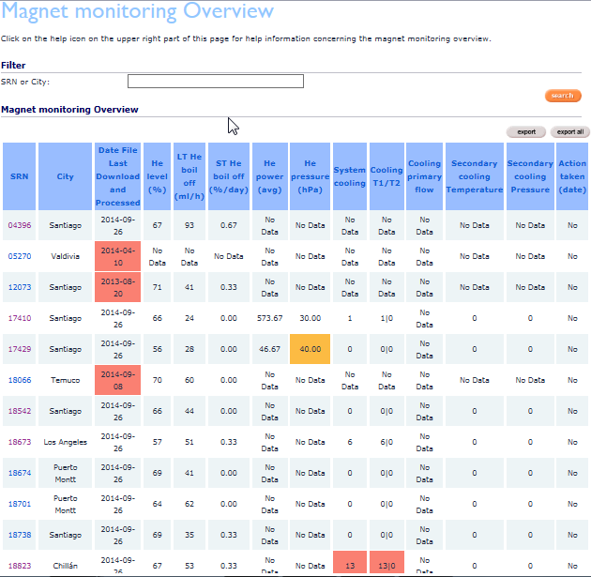

RADAR example: Magnet monitoring overview
Radar: Remote Application for Diagnostics Analysis and Reporting
4
October 2014 South LATAM Operations Confidential

Slide 33
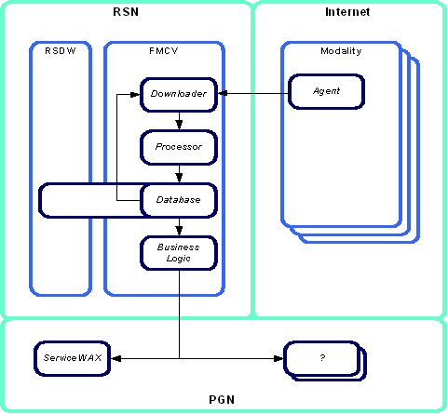
RADAR Architecture

Slide 34
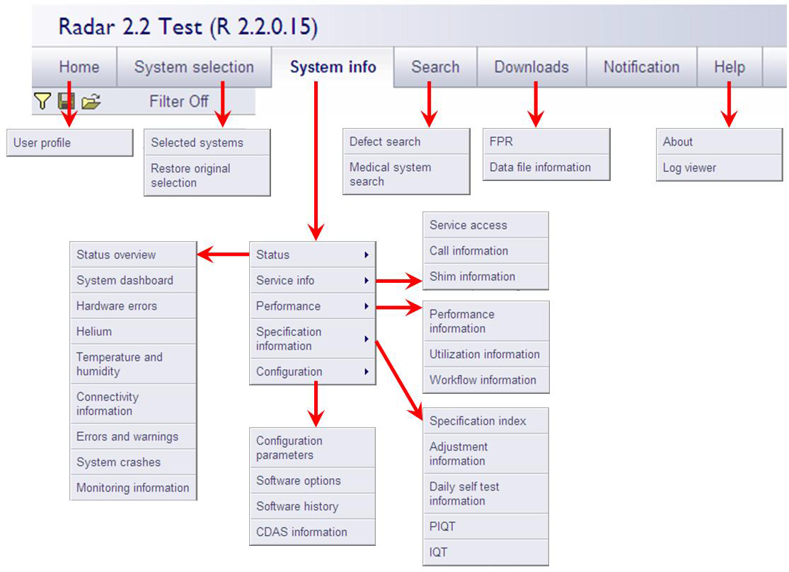

Slide 35
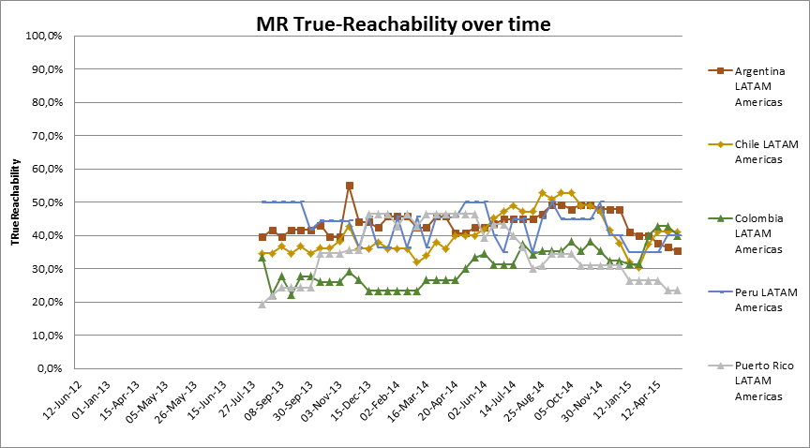
True Reachability ranking LATAM
15
October 2014 South LATAM Operations Confidential

Slide 36
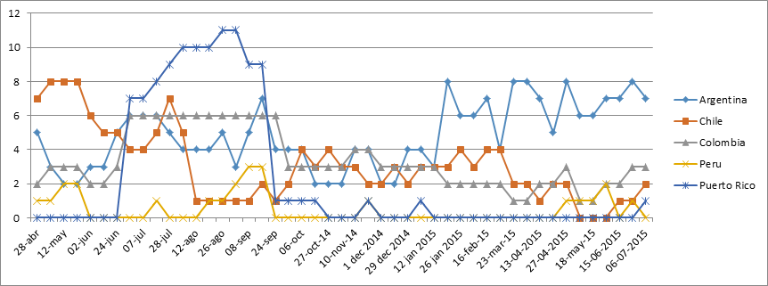
Proactive monitoring LATAM
25
October 2014 South LATAM Operations Confidential

