Slide 1
MR Advanced Specialist training LATAM By Fred Kunst & Ricardo Flores
MR Field Support & Education
Week 21 2013

Slide 2
Agenda
IQ
PRS
Troubleshooting Guide LATAM and MR consumption Program, Newsletter
RF coil Analyzer program
Magnet
Logfiles and Log tool program
Spurious
Spikes
MHP
Ingenia
20 October 2014 Confidential

Slide 3

Meet the Artifacts
MR Field Support & Education
Week 21 2013

Slide 4
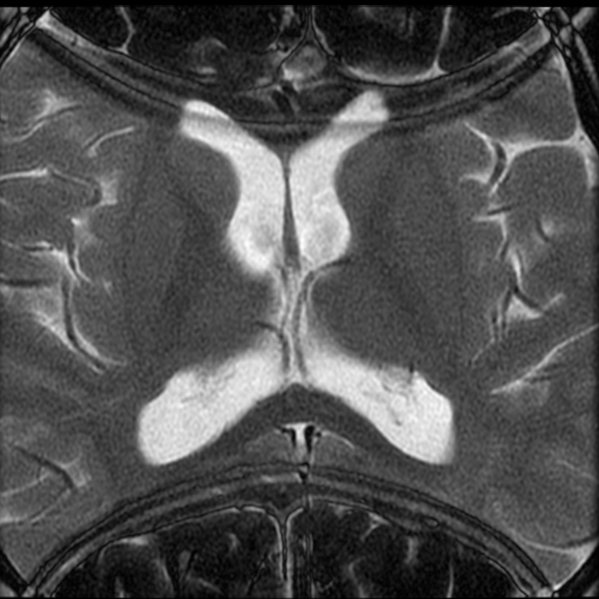
Outline
Artifact: Any irregularity noted in an MR image which is related to the imaging process rather than to an anatomical or physiological abnormality.
Categories
Causes

Slide 5
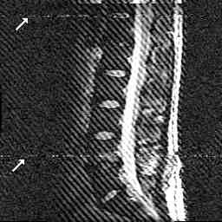
Artifacts Types
Clinical artifacts
sensitivity of imaging process to characteristics of patient
setting of scan parameters (operator)
Technical artifacts
system configuration/condition
HW (system type), SW (release)
degradation/malfunction
(adjustment, repair)
environmental factors
hospital equipment (injector)
radio stations
moving cars, lifts

Slide 6
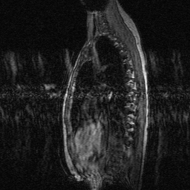
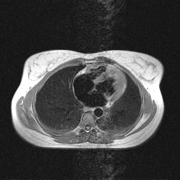
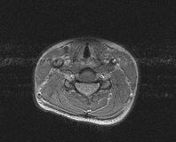
Patient Related Motion
Object and background, ghosting/blurring is caused by motion
Gross patient motion
Physiologic motion
Respiration
Cardiac
Peristaltic
Flow

Slide 7
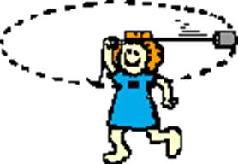
Patient Related Motion
Motion that can be compensated for
Periodic
cardiac motion (rapid acquisition, VCG, navigator)
respiratory motion (rapid acquisition, REST, breath-hold, VCG, navigator)
blood flow (flow compensation, REST, VCG)
CSF pulsation (VCG, PPU)

Slide 8
Patient Related Motion
Motion that is more challenging to compensate for
Aperiodic
Peristalsis (rapid acquisition)
Swallowing (REST)
Eye movement (proper instruction such as close eyes during scans, picture in bore, small mark in bore, etc.)
Coughing

Slide 9
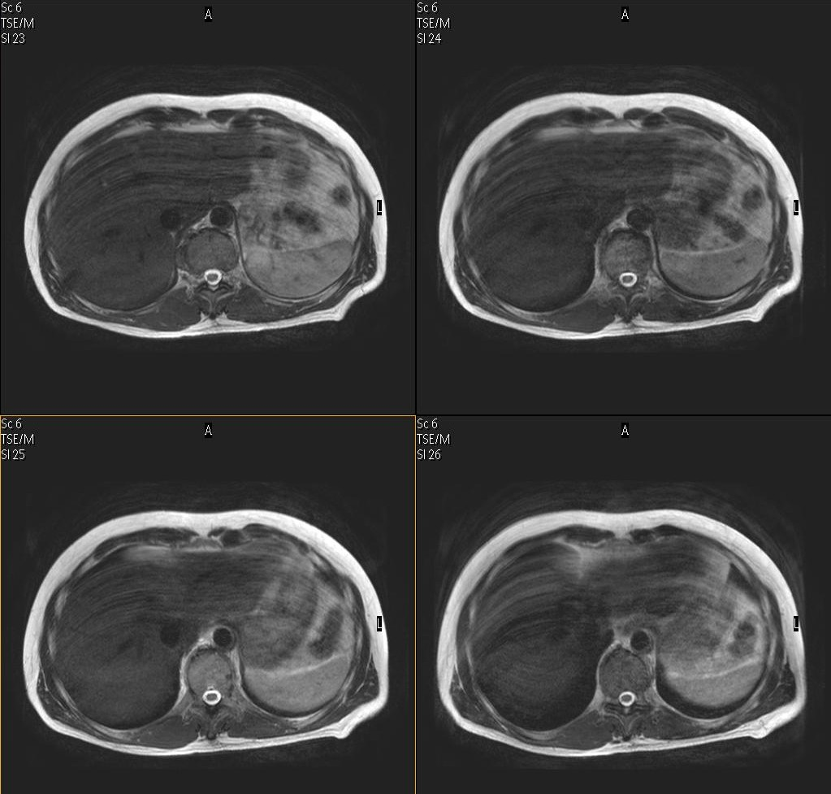
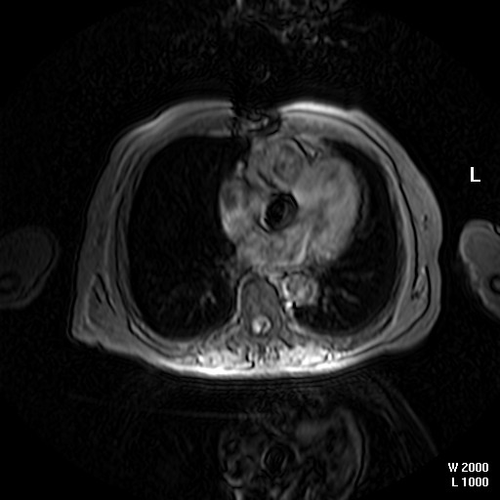
Patient Set-up/Preparation
Motion compensation related artifacts
Cardiac motion
Respiratory motion

Slide 10
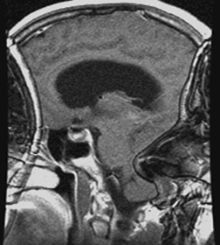
Foldover
Also known as:
Aliasing
Back-folding
Wrap around
Phase wrap
Overlap
Occurs:
In phase encoding direction if FOV in phase encoding direction is smaller than the imaged object
Seldom in frequency encoding direction, because of 2 times over-sampling
Phase
behaviour

Slide 11
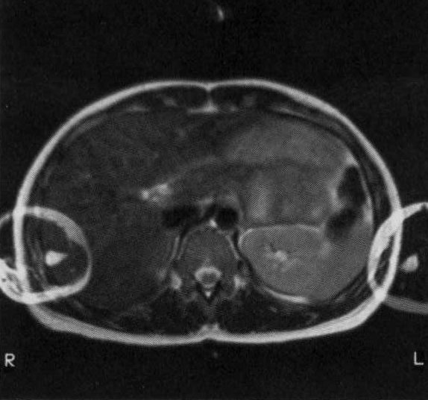
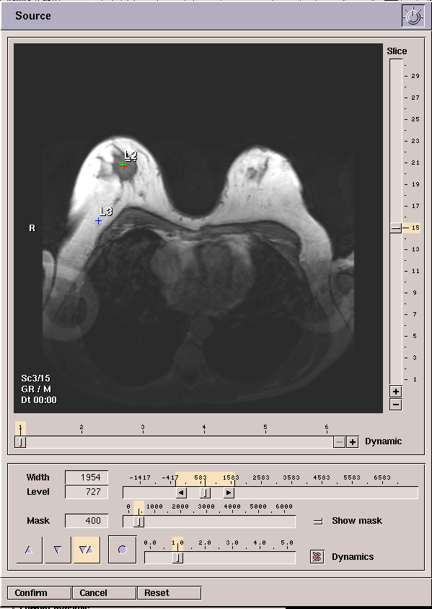
Foldover
Relevant Parameters
FOV (in foldover direction)
Foldover direction itself
Position of slices/FOV (offsets)
Foldover suppression:
Over-sampling (via NSA on Achieva)
Regional saturation (REST)
Coil type
A surface coil has a limited sensitivity
SENSE (changes where the artifact occurs)

Slide 12
Foldover
Foldover in Slice Direction (3D)
With SENSE…
Foldover in center of image
Can be seen if SENSE factor
or oversample factor
Both methods to reduce scan time

Slide 13
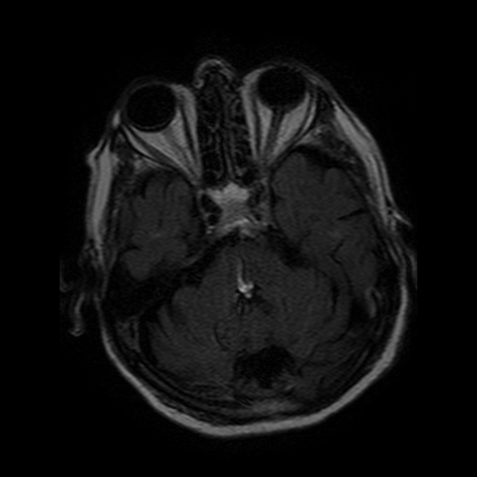
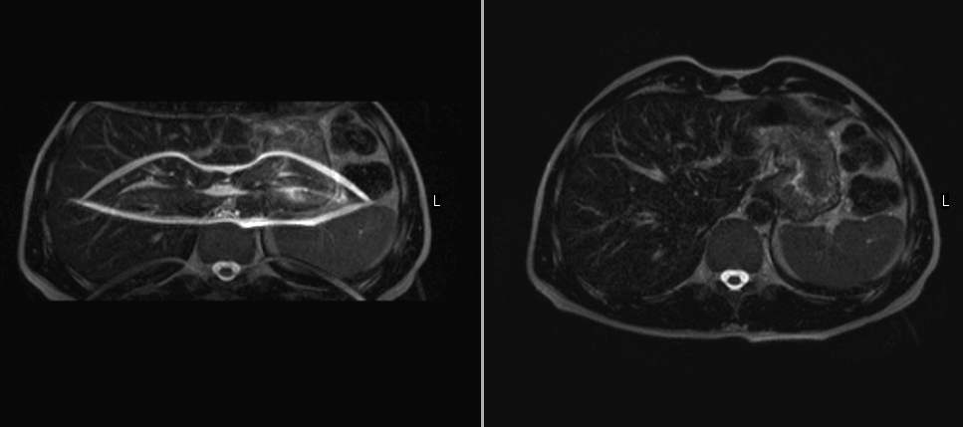
SENSE
FOV too small
3 points overlap
Results in artifact
A
B
C
Notes:
The artifact in the middle of the image is caused by backfolding in combination with SENSE. With SENSE it is important to have the (R)FOV large enough in the foldover/ SENSE direction as backfolding will appear in the middle of an image (when SENSE factor 2 is applied).
In this case, (like in all brain examinations) it is important to check whether or not the ears are totally included in the (R)FOV.

Slide 14
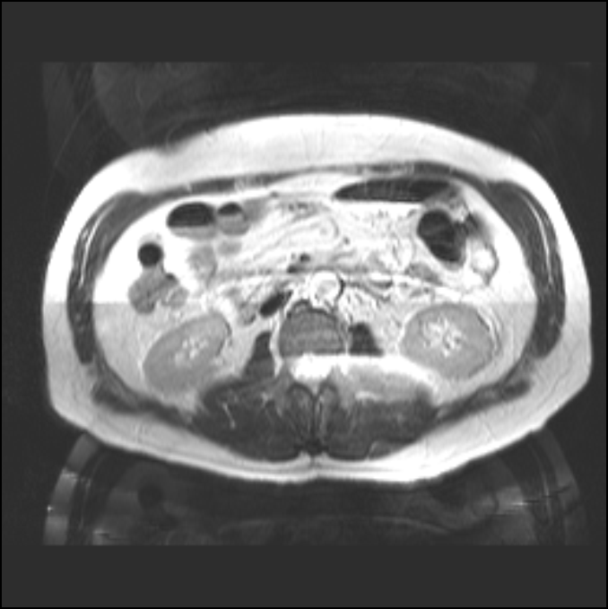
SENSE
Coil movement
The reference-scan provides us with coil-sensitivities...
If the coils have not moved in-between
Cause: coil movement due to breathing
Split-line artifact

Slide 15
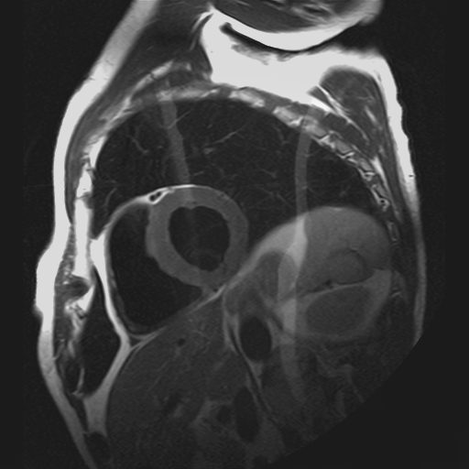
SENSE
High signal of fat leads to incorrect estimation of sensitivity close to coil
High signal intensities (fat) are still visible
For example - seen with SCC and SBC close to object
Use of special SENSE cushions required where available

Slide 16
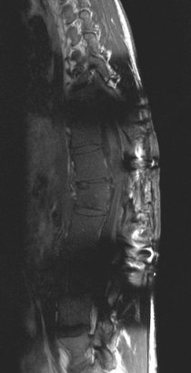
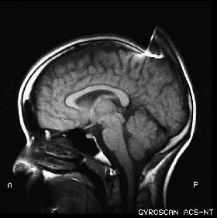
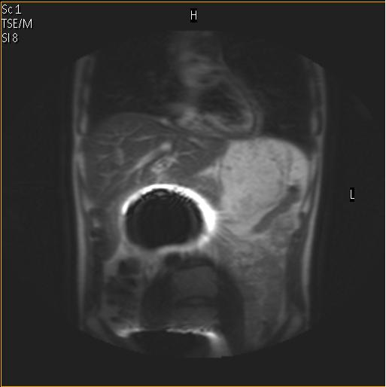
Patient Related
Metallic Implants/Appliances
Internal
Surgical clips/staples/shunts/etc.
Dental implants/appliances
External
Jewelry, buckles
Piercings
Metallic stitching in clothing
Hairpins, some hairpieces/wigs
Make up
Tattoo’s
Note: these items may sometimes also cause a burn risk

Slide 17
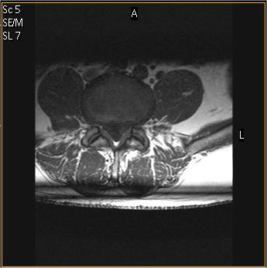
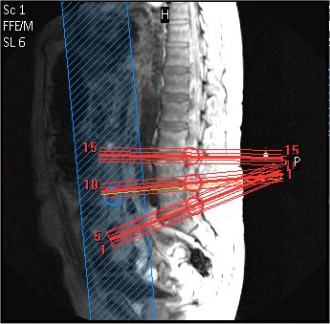
Planning
Cross-talk (Multi-stack sequences)
Can be prevented by setting scan parameter “stacks as packages” to yes
Note: This will increase scan time
Notes:
Also by careful planning to avoid cross-over

Slide 18

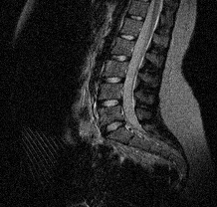
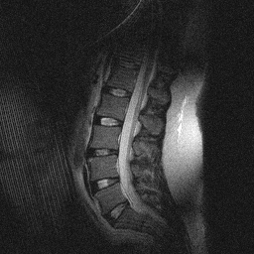
Planning
Intersecting REST Slabs
Leading to “corduroy” artifacts
Not to be confused with corduroy artifacts caused by technical issues
Those caused by REST tend to be localized

Slide 19
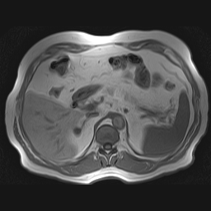
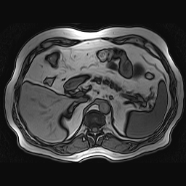
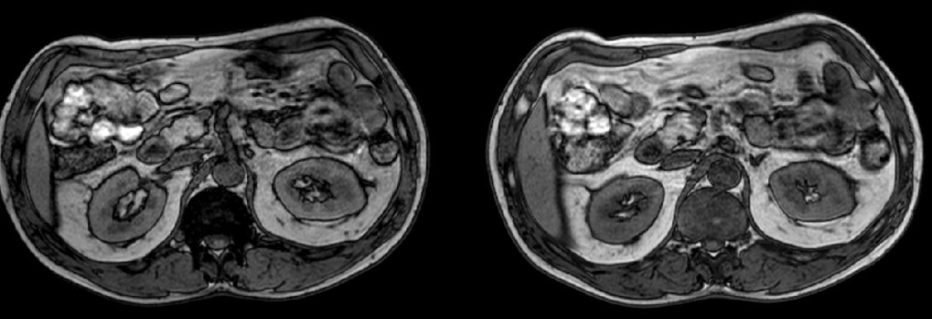
Protocol
Out of Phase TE in T1 FFE
Often occurs when an operator notices a dramatic increase in the RSL when adjusting the Water-Fat Shift.
In a sequence with “shortest” TE
Common among GE operators used to making bandwidth adjustments
In Phase TE
Out Phase TE

Slide 20
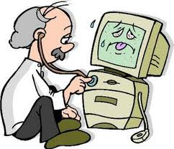
Technical/non-applications issues
System is the source
Hardware components
Condition of those components - degradation over time

Slide 21
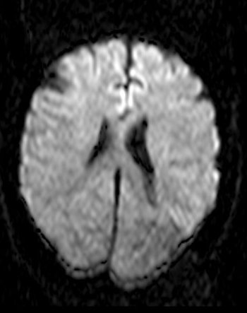
Technical/non-applications issues
Double contour artifact
SSh-DWI
Isotropic image
‘Double contour’ or ‘Pixel Shift’artifact
Can be related to Eddy Currents

Slide 22
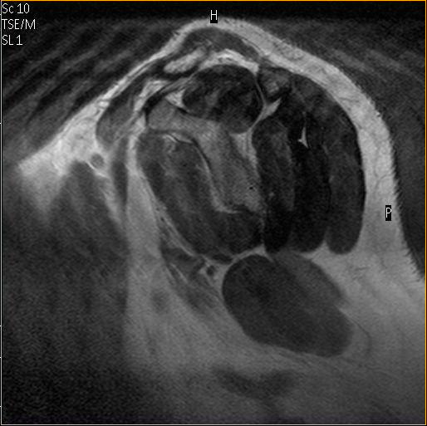
Technical/non-applications issues
Blurring/Ghosting
If seen in the imaged object only, it could have been caused by missing high order profiles
Note clean background above
If no patient motion is apparent this
result could be caused by a hardware
issue

Slide 23
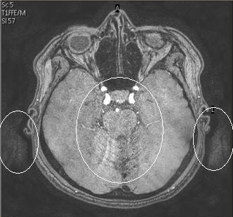
Technical/non-applications issues
Blurring/Ghosting with SENSE
Increased noise
‘Clouds’ in background
Seen with SENSE scans
With all coils
4 bad receive channels in the system found in this example

Slide 24
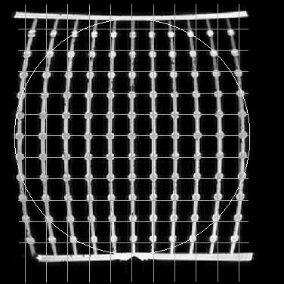
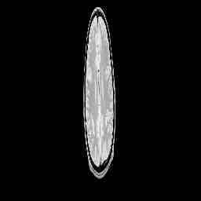
Technical/non-applications issues
Distortion
Caused by magnetic field imperfections
Field imperfections can arise from:
B₀-field (shimming)
Gradient field
Ferro magnetic materials
Non-ferromagnetic materials, susceptibility
These field imperfections will be superimposed on the frequency encoding gradient and result in mismapping of image data
Gradient Echoes are much more sensitive for magnetic field imperfections than Spin Echoes because there is not a re-phasing 180º pulse
Non-linear gradients
Defective gradient amplifier

Slide 25
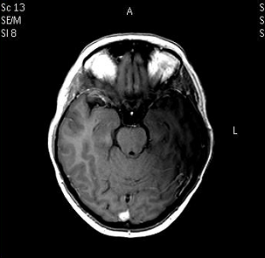
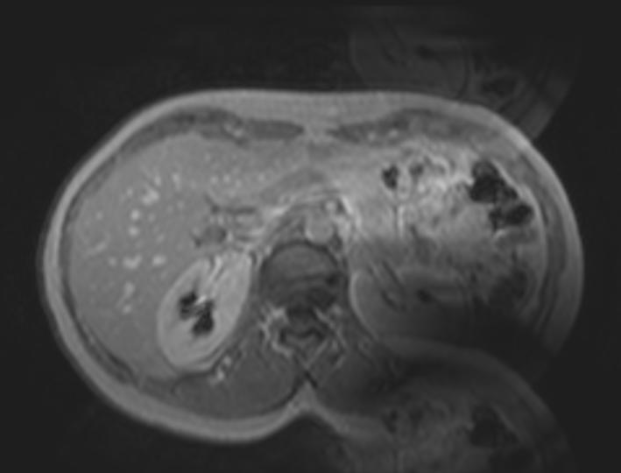
Technical/non-applications issues
Image Inhomogeneities
RF coil sensitivity related
SBC Coil Element Failure
SHC Coil Element Failure

Slide 26
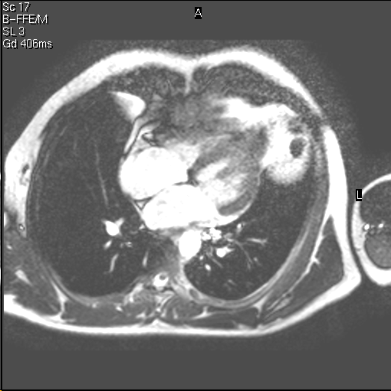
Technical/non-applications issues
Defective coil element leading to SENSE noise breakthrough
Differs from traditional SENSE noise breakthrough which can sometimes be seen in an image by focused location and appearance coinciding with a coil element location

Slide 27

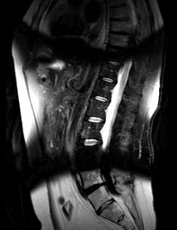
Technical/non-applications issues
Image Inhomogeneities
In this case, it is proven that the shimming was the problem. The phantom images show far too many lines. (Each black/white alternation is one PPM. 2 PPM can cause fat suppression failure.)
Normally this is far more subtle
Complete failure of SPIR

Slide 28
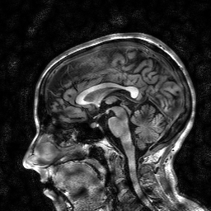
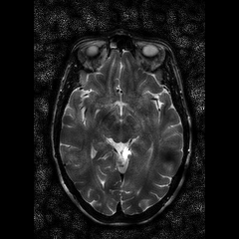
Technical/non-applications issues
Image Inhomogeneities
“Dark spots in SENSE scan”
Seen with all coils, using SENSE or CLEAR
Ref-scan data suspected

Slide 29
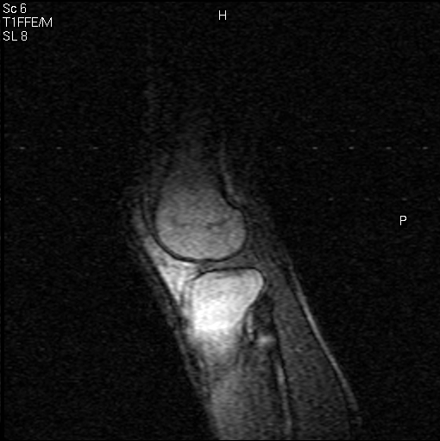
Technical/non-applications issues
RF Interference – multiple possible causes
Spurious signal – dot artifact

Slide 30
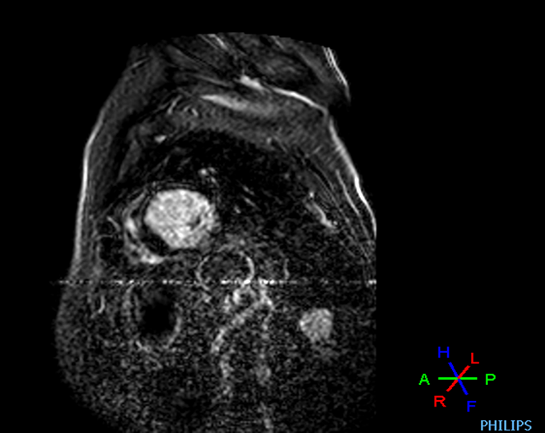
Technical/non-applications issues
RF Interference – multiple possible causes
Cardiac study
Line artifact, noise
Exchanged battery, no change
Replaced leads, no change
Replaced VCG module, fixed

Slide 31
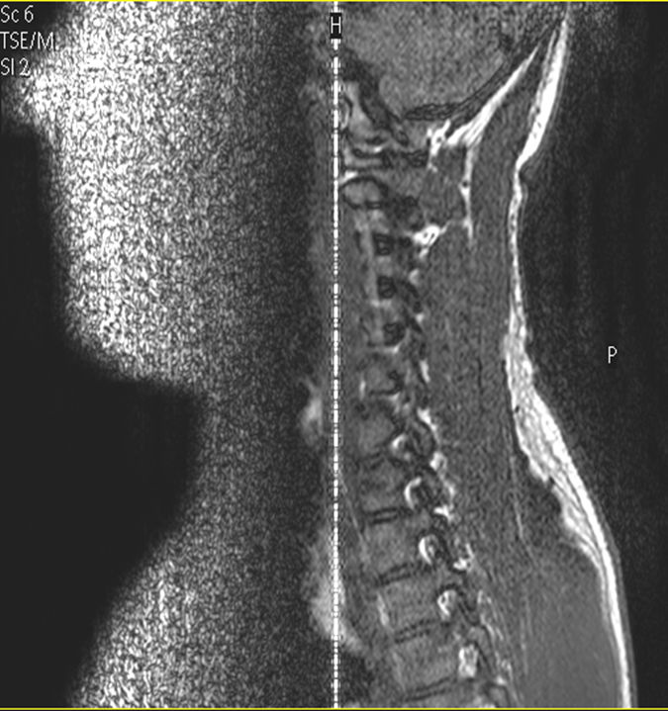
Technical/non-applications issues
RF Interference – multiple possible causes
Intera Nova 1.5T
R11.1.2.0
Line artifact
With all coils
One slice
Intermittent
Defective filter in gradient cables

Slide 32
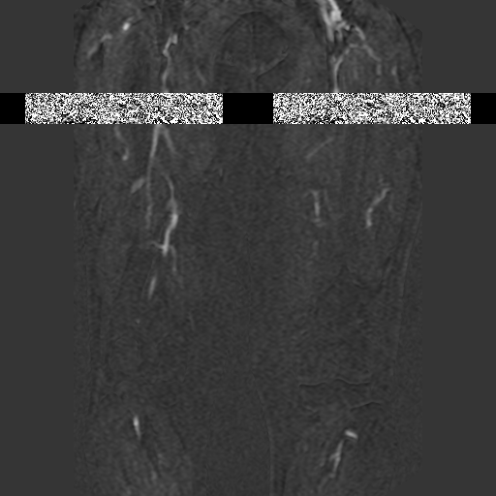
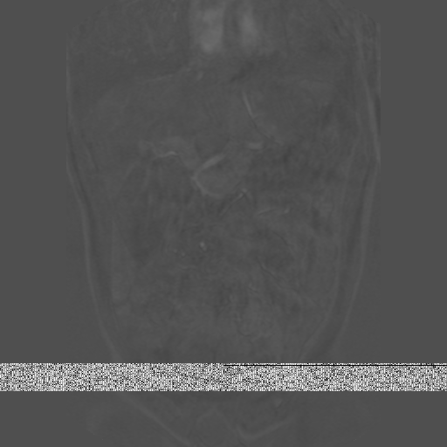
Technical/non-applications issues
Band Artifact
Problem resolved when host computer was replaced

Slide 33
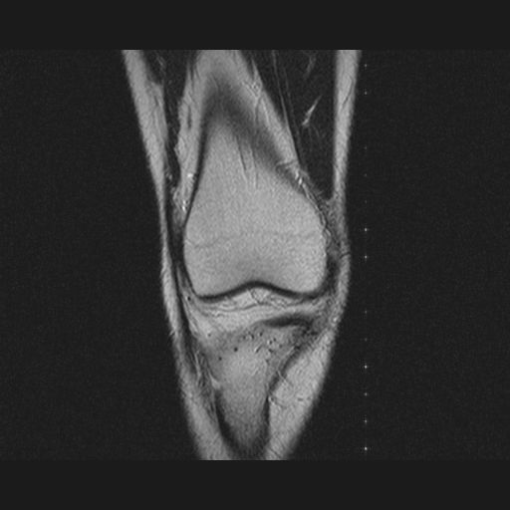
Environmental
RF Interference
Dots
Customer installed a mobile respiration device in the MR room
And..?
The power cable was plugged to an AC outlet outside the RF cage, and the cable was routed into the RF cage through the wave guides and not through the RF cage filters.

Slide 34
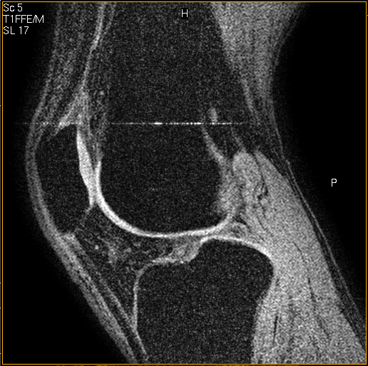
Environmental
RF Interference
Line artifact
Possible causes:
RF door open
3rd party equipment

Slide 35
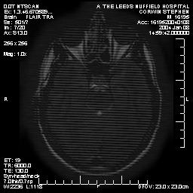
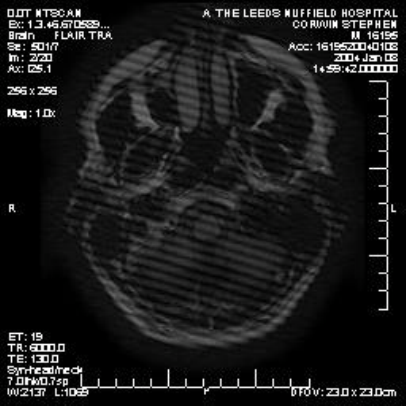
Environmental
Zebra Stripes
Seen after a temporary repair of the false ceiling; tiles not properly mounted
After final repair problem was gone
(FSE meeting the maintenance man was purely coincidental)

Slide 36
Ways to Minimize Artifacts Artifacts can never be completely eliminated, after all…
Prevent (before)
Well adjusted system
Patient screening
Proper patient set up
Suppress (during) or reduce during acquisition of data
Use of artifact reduction techniques (triggering, gating, REST…)
Appropriate scan parameters settings (FOV, offsets,..)

Slide 37
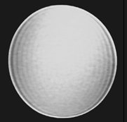
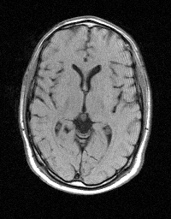
It’s just physics!
Contrast jump
in object
Reconstruction
Also known as:
Gibb’s artifact
Ringing artifact
Spectral leakage
Seen with low matrix
Phase matrix <<100%
FFT
Appearance
in image

Slide 38
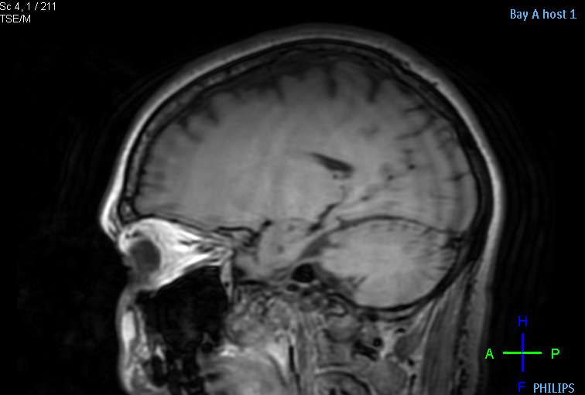
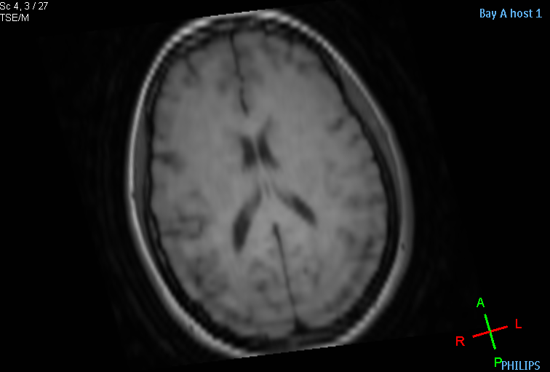
It’s just physics!

Slide 39



It’s just physics!
Half Field of View ghost
Also known as:
Nyquist ghost
N/2 ghost (N = scan matrix)
Typical artifact in EPI
Single shot EPI: ghost shifted over ½ FoV in phase encoding direction
Multi shot EPI: ghost shifted over FoV/2*#sh, more complex pattern
No ghosting
Ghosting in a single shot EPI
Ghosting in a 4 shot interleaved EPI

Slide 40

It’s just physics! Check 3T AW
Quadrupole Effect
Certain body parts exhibit eddy currents when placed in a RF magnetic field
Often within the periphery of the torso
Magnitude of currents depends on tissue composition and field strength
Patient dependent
Body area dependent
The effect worsens with increasing field strength
Appearance
Left / right SI differences in coronal plane
Diagonal SI differences in transverse plane

Slide 41
Information required for investigation IQ problems
Complete DICOM dataset including Survey and other scans from scanner (otherwise protocol investigation not possible)
Clear description of problem
Screen grab to show artifact
Intermittent or reproducible
Relation with coil(s)/patient types/scan techniques
Describe the workflow in case it is workflow dependent
What actions have already been performed
Include Field strength, SW release nr, SP
Name of application specialist involved
Corresponding VIPER or mercury numbers

Slide 42

Teaming up to create loyal Ingenia customers,
delighted from the start
Asdrubal Mata, Arne van de Wijdeven
MR Field Support & Education
Reviewed and approved by Eric Jean GM MR & John Olierook leader MR Customer Service dd Nov 15 2012
Week 21 2013

Slide 43
Summary of proposal
Create promoters out of existing and new Ingenia users
Ensure unconditioned siting process, good installation & documentation, handover and follow up with technical assessments to drive reliability and uptime
Assess existing protocols/ customer expectations/ wishes before installing and ensure out of the box protocols meet these requirements
Delight customer with delivering onsite support to operators for workflow experience and to radiologists for IQ improvements
Fast field feedback on issues and complaints to ensure high response time and delivering upon expected quality of repair
Regular management presence to check in on temperature
Elevate capability of local field service and applications organization
Build up team of BIU and Latam into a core operational team. Pull together and report out to steering team with BU/Latam/CS/OPS/Gailing/SPS management
Involve BU experts to remotely bring all FSEs and application resources up to speed on Ingenia learning/ FAQ/ system behaviors/ differences to Achieva/Intera/Panorama. Repeat frequently.
During tours team up BIU and Latam experts to build the confidence in maintaining and supporting Ingenia
Use system time once available to train real life customer issues (spike training, spurious training, ……)
Drive sales for new Ingenias in Latam and improving brand image
Already now, we managed to get SMS and GE users to start using our wide bore platform. These would be extremely strong showsites
Promoter sites need to become show sites and have “guaranteed” operator capability and well trained FSEs
Frequent customer contacts bring indications for sales opportunities

Slide 44
Local expert system tools
Screen grabs (Alt + Print Screen), Use Windows Mspaint
Movie files of user actions, Use Windows Media Encoder
DICOM export data set to Disk Files (and compress the E:\Dicom folder)
Command prompt for executing commands
Logd (real time logging)
Permproc commands
Activate_configuration.pl (without reboot, is faster)
Logging tools and interpretation, see next slides
Advanced diagnostic tools:
RF chain diagnostics
Gradient diagnostics
Noise analysis and measurements
Spike searching
Spurious searching

Slide 45
Remote expert tooling
RADAR: to check system (trend) info (delay of 1 or more days)
M2M: to get alerts and check magnet/cooling parameters (delay 15 min)
RSN: to check and download real time info
FSF: to check and configure
s-FTP: to download/upload files
SSH: command line interface to browse/execute commands
Coil analyzer tool v2.0: check coil connection errors (use logstat files)
Field Data View:
Ingenia Analysis
High Activity sites
Traffic board Ingenia
Customer temperature dashboard
System costs overviews
And lot’s of more info…..

Slide 46
RSN
2
RADAR
4
Field data view
All connected Systems
1
3
NetForum
M2M
SAP: BW
4
HAS
SAP: CS-DWH
6
1 FSE and RSN Champion (local team)
2 ISCS
3 GCS
4 CS program manager
5 ICR
6 IT
Notes:
If any additional information is needed feel free to add or change the slide.

Slide 47
Magnets
MR Field Support & Education
Week 21 2013

Slide 48

Agenda magnets
Latham service organization
Quench procedure
Stuck Helium probe
STT magnet file

Slide 49
Latham service organization (simplified)
Customer
Market
BIU
VIPER/Clarify/ OneEMS
Latham (magnet group)
Customer problem
Magnet related
Country / Region support
Best
Magnet related issues handled by the Latham service team (through normal support channels – VIPER/Clarify/OneEMS)
All system related issues (SW, IQ, Coils, etc.) handled by the Best service teams
So if a magnet quenches multiple times..  Support by Latham service team
(Mike McCormick and Robert Valentine)

Slide 50
Quench procedure
Quench questionnaire, magnet audit file, de-icing procedure etc. to be found on InCenter: http://incenter.medical.philips.com/doclib/fetch/2000/4504/4396/4402/557717/561307/561389/6653646/DMR117040.htm.html?nodeid=6655929&vernum=0
Important highlights
VIPER/Escalation to be opened with all required data attached  Magnet audit file, Quench Questionnaire, Hioki trace (if available), RMMU log file, Logcurrent.log file, STT_magnet.xls file, De-ice log file (10K only)
Every quench to be reported via the Customer Feedback Portal for tracking, trending and root cause investigation
Short term action plan through VIPER/OneEMS, root cause analysis through Customer Feedback
VIPER/Escalation only to be opened in case of multiple (≥2) spontaneous quenches and when customer temperature is rising 
Example A: 4 Quenches in 3 years can be a valid escalation.
Example B: 3 Quenches in 9 years might not be a valid escalation and root cause will follow through Complaint investigation.

Slide 51
Stuck Helium probe
Newsletter MR256
Two types of incorrect readings
Reading jumps between 2 different readings
Helium reading stops decreasing and stays constant (only 10K – F2000 and Titan)
No validated cause for reading failures
Identifying systems with stuck Helium probe
Monitoring the He level is part of regular maintenance
Service actions as cold head rebuild, ramping or cooling system maintenance will cause temporary boil-off and should cause a change in He level (if not  stuck)
10K systems  constant LHe level for more than 4 weeks is suspicious
Dealing with stuck probes
Always submit a complaint via the Customer Feedback Portal
Follow service procedure described in MR256 (i.e., backup probe, reverse polarity cable, probe de-ice)
In the end, if no option will solve the issue, Latham will be involved

Slide 52

STT magnet file

Slide 53

The art of logfile reading
MR Field Support & Education
Week 21 2013

Slide 54

Where does logging come from
Operating system
Background processes
Foreground processes
Gradient amplifier firmware
Windows resource monitoring

Slide 55

Which logfiles exist
logcurrent.log all MR processes on current day
log2012060600000.log all MR processes at specific day
logstat201206.log extract of logfile for specific month
Examcards20120326T111535_dump.log examcard crash
gyroview_win_20120521_crash.log gyroview crash
cdas_20120529_224020_dump.log crash of process at CDAS
GRADDUMP_20120218140945.log gradient amplifier error
errorlog_DBServer_20120521232317.log Database logging
monitoring_counters_2012052207074332 performance monitor
el_20120521234500_application.log Windows logging
el_20120521234500_security.log Windows logging
el_20120521234500_system.log Windows logging
…..

Slide 56

Normal workflow
Start system SYS: r
New exam (from RIS) CA_RPDI_NewExamDialog::ConnectToRIS / SYS: p
Wrap-up patient lightvisor reference position defined
Load examcard Exam card name set in the data base
Start survey scan START_SCAN: (pressed by user at ScanStatusWindow)
Plan anatomic scans --> BeginPlan / <-- BeginPlan / --> BeginEdit / <-- BeginEdit
Scan various scans Scan starts / Scan progress msg -> SCANEXEC / Scan completed
Evaluate images with radiologist User entering ViewingContext/PicturePlus
Perform optional intervention Waiting for start of dynamic study / Performing breath hold
Postprocessing data PictorialIndex(UserEvent): (Action) Click series / StateChanged for package
Archive data Performance Logging [ArchiveNetwork] 205203816 event Job Started
End of examination (usually not clearly indicated)
Next examination …..

Slide 57

Normal daily workload: Search/query “SYS:”
J:\logging\38135\log201205300000.log(26): ] 2012-05-30 00:00:07.73 D S Aswcheck 00000afc 00000c14 <STATSIF SYS: r release 3.2.2.0 , swid 119 , language en-US , roles SystemAdmins
J:\logging\38135\log201205300000.log(2060): ] 2012-05-30 00:01:53.73 D S GYROVIEW 00000bf0 0000086c <STATSIF SYS: p exam_3677_3677_
J:\logging\38135\log201205300000.log(16872): ] 2012-05-30 01:39:02.18 D S GYROVIEW 00000bf0 0000086c <STATSIF SYS: p exam_3671_3671_
J:\logging\38135\log201205300000.log(71885): ] 2012-05-30 07:18:20.71 D S GYROVIEW 00000bf0 0000086c <STATSIF SYS: p exam_3704_3704_
J:\logging\38135\log201205300000.log(102896): ] 2012-05-30 07:49:30.31 D S GYROVIEW 00000bf0 0000086c <STATSIF SYS: p exam_3708_3708_
J:\logging\38135\log201205300000.log(117834): ] 2012-05-30 08:01:18.54 D S GYROVIEW 00000bf0 0000086c <STATSIF SYS: p exam_3711_3711_
J:\logging\38135\log201205300000.log(138728): ] 2012-05-30 08:27:57.40 D S GYROVIEW 00000bf0 0000086c <STATSIF SYS: p exam_3717_3717_
J:\logging\38135\log201205300000.log(192556): ] 2012-05-30 09:02:40.07 D S GYROVIEW 00000bf0 0000086c <STATSIF SYS: p exam_3725_3725_
J:\logging\38135\log201205300000.log(219944): ] 2012-05-30 09:27:32.43 D S Aswcheck 00000afc 00000dd8 <STATSIF SYS: s
J:\logging\38135\log201205300000.log(220773): ] 2012-05-30 09:31:32.95 D S Aswcheck 00000434 000014e4 <STATSIF SYS: r release 3.2.2.0 , swid 119 , language en-US , roles SystemAdmins
J:\logging\38135\log201205300000.log(222460): ] 2012-05-30 09:33:20.14 D S GYROVIEW 00001210 00000954 <STATSIF SYS: p exam_3725_3725_
J:\logging\38135\log201205300000.log(239577): ] 2012-05-30 09:48:04.60 D S GYROVIEW 00001210 00000954 <STATSIF SYS: p exam_3803_3803_
J:\logging\38135\log201205300000.log(289888): ] 2012-05-30 10:34:17.34 D S GYROVIEW 00001210 00000954 <STATSIF SYS: p exam_3813_3813_
J:\logging\38135\log201205300000.log(332592): ] 2012-05-30 11:06:43.48 D S GYROVIEW 00001210 00000954 <STATSIF SYS: p exam_3819_3819_
J:\logging\38135\log201205300000.log(363118): ] 2012-05-30 11:40:11.82 D S GYROVIEW 00001210 00000954 <STATSIF SYS: p exam_3825_3825_
J:\logging\38135\log201205300000.log(402379): ] 2012-05-30 12:04:49.56 D S GYROVIEW 00001210 00000954 <STATSIF SYS: p exam_3830_3830_
J:\logging\38135\log201205300000.log(429379): ] 2012-05-30 12:32:21.42 D S GYROVIEW 00001210 00000954 <STATSIF SYS: p exam_3836_3836_
J:\logging\38135\log201205300000.log(463786): ] 2012-05-30 13:09:16.32 D S GYROVIEW 00001210 00000954 <STATSIF SYS: p exam_3842_3842_
J:\logging\38135\log201205300000.log(493055): ] 2012-05-30 13:30:55.81 D S GYROVIEW 00001210 00000954 <STATSIF SYS: p exam_3847_3847_
J:\logging\38135\log201205300000.log(493161): ] 2012-05-30 13:31:38.34 D S GYROVIEW 00001210 00000954 <STATSIF SYS: p exam_3400_3400_
J:\logging\38135\log201205300000.log(493510): ] 2012-05-30 13:31:55.35 D S GYROVIEW 00001210 00000954 <STATSIF SYS: p exam_3847_3847_
J:\logging\38135\log201205300000.log(520427): ] 2012-05-30 13:57:43.43 D S GYROVIEW 00001210 00000954 <STATSIF SYS: p exam_3852_3852_
J:\logging\38135\log201205300000.log(555360): ] 2012-05-30 14:34:00.85 D S GYROVIEW 00001210 00000954 <STATSIF SYS: p exam_3671_3671_
J:\logging\38135\log201205300000.log(583173): ] 2012-05-30 14:55:30.07 D S GYROVIEW 00001210 00000954 <STATSIF SYS: p exam_3858_3858_
J:\logging\38135\log201205300000.log(622600): ] 2012-05-30 15:21:11.25 D S GYROVIEW 00001210 00000954 <STATSIF SYS: p exam_3861_3861_
J:\logging\38135\log201205300000.log(651269): ] 2012-05-30 15:51:24.51 D S GYROVIEW 00001210 00000954 <STATSIF SYS: p exam_3869_3869_
J:\logging\38135\log201205300000.log(697455): ] 2012-05-30 16:22:19.67 D S GYROVIEW 00001210 00000954 <STATSIF SYS: p exam_3870_3870_
J:\logging\38135\log201205300000.log(738551): ] 2012-05-30 16:51:51.28 D S GYROVIEW 00001210 00000954 <STATSIF SYS: p exam_3882_3882_
J:\logging\38135\log201205300000.log(778430): ] 2012-05-30 17:18:49.18 D S GYROVIEW 00001210 00000954 <STATSIF SYS: p exam_3888_3888_
J:\logging\38135\log201205300000.log(799928): ] 2012-05-30 17:35:24.20 D S GYROVIEW 00001210 00000954 <STATSIF SYS: p exam_3892_3892_
J:\logging\38135\log201205300000.log(844498): ] 2012-05-30 18:17:43.76 D S GYROVIEW 00001210 00000954 <STATSIF SYS: p exam_3898_3898_
J:\logging\38135\log201205300000.log(887209): ] 2012-05-30 18:50:52.75 D S Aswcheck 00000434 0000279c <STATSIF SYS: s
J:\logging\38135\log201205300000.log(888843): ] 2012-05-30 18:54:54.18 D S Aswcheck 00001484 00001488 <STATSIF SYS: r release 3.2.2.0 , swid 119 , language en-US , roles SystemAdmins
J:\logging\38135\log201205300000.log(893328): ] 2012-05-30 18:57:00.14 D S GYROVIEW 00001974 0000197c <STATSIF SYS: p exam_4000_4000_
J:\logging\38135\log201205300000.log(954322): ] 2012-05-30 19:33:12.39 D S GYROVIEW 00001974 0000197c <STATSIF SYS: p exam_4006_4006_
J:\logging\38135\log201205300000.log(967351): ] 2012-05-30 19:47:20.68 D S GYROVIEW 00001974 0000197c <STATSIF SYS: p exam_4008_4008_
J:\logging\38135\log201205300000.log(984812): ] 2012-05-30 20:03:17.87 D S GYROVIEW 00001974 0000197c <STATSIF SYS: p exam_4015_4015_
J:\logging\38135\log201205300000.log(985438): ] 2012-05-30 20:08:47.43 D S GYROVIEW 00001974 0000197c <STATSIF SYS: p exam_4016_4016_
J:\logging\38135\log201205300000.log(1016648): ] 2012-05-30 20:30:08.75 D S GYROVIEW 00001974 0000197c <STATSIF SYS: p exam_4021_4021_

Slide 58

Meaning of SYS
SYS: r system start
SYS: p new patient
SYS: m missing process → crash, system restart required
SYS: s system stop
SYS: a process crashed, no restart required
SYS: h crashed process restarted
SYS: b process crashed, restart required
SYS: u process not started, ask user to restart process
SYS: n user selected not to restart process
SYS: y process restarted by user
SYS: c process startup cancelled by user
SYS: I process crashed, however ignore
SYS: o process crashed and stop system
SYS: d process crashed, notify user and stop system
A system power down is not logged, only seen as a system start without preceding stop.

Slide 59

Negative events
Process crash automatic recovery by restart of process
System crashes recover by system restart
Scan aborts retry scan
System down not recoverable, reschedule planned examinations

Slide 60

Search policies for a crash
Search for “SYS:” (use logstat files to cover large timespan)
Goto crash in logfile
Search upward (back in time) to first stack dump after normal system operation
Look for unique string in stackdump
Only when two stackdumps are identical, two crashes are identical.
Or
Look for gap in time sequence and subsequent system restart
Look for last user action/message before gap in timeline occurs

Slide 61

Software crash
2012-04-04 08:47:21.67 D S GYROVIEW 00000bd4 00000db0 <STATSIF SYS: p exam_7566_7566_
2012-04-04 09:05:56.85 D S GYROVIEW 00000bd4 00000db0 <STATSIF SYS: p exam_7567_7567_
2012-04-04 09:32:09.68 D S GYROVIEW 00000bd4 00000db0 <STATSIF SYS: p exam_7573_7573_
2012-04-04 10:06:46.46 D E MRBootstrap 00000b0c 000006dc <STATSIF SYS: d Process spectropostproc crashed. Setting statisticsflag, notifying user and stop the system.
2012-04-04 10:06:50.90 D E MRBootstrap 00000b0c 00003fb4 <STATSIF SYS: d Process GyroView crashed. Setting statisticsflag, notifying user and stop the system.
2012-04-04 10:06:51.00 D E MRBootstrap 00000b0c 00003cb8 <STATSIF SYS: d Process spectrodisplay crashed. Setting statisticsflag, notifying user and stop the system.
2012-04-04 10:06:51.07 D E MRBootstrap 00000b0c 000006dc <STATSIF SYS: d Process interactiveviewer crashed. Setting statisticsflag, notifying user and stop the system.
2012-04-04 10:06:51.15 D E MRBootstrap 00000b0c 00003cb8 <STATSIF SYS: d Process scannerstatus crashed. Setting statisticsflag, notifying user and stop the system.
2012-04-04 10:07:12.28 D S Aswcheck 00001348 000006a8 <STATSIF SYS: m
2012-04-04 10:07:28.64 D E MRBootstrap 00000b0c 000006dc <STATSIF SYS: o Process Aswcheck failed to start. Statistics flag is set. Abort loading and stop the system.
2012-04-04 10:07:48.71 D E MRBootstrap 00000b0c 00003fb4 <STATSIF SYS: o Process Aswcheck failed to start. Statistics flag is set. Abort loading and stop the system.
2012-04-04 10:11:58.17 D S Aswcheck 00001720 000016d4 <STATSIF SYS: r release 3.2.2.0 , swid 119 , language en-US , roles SystemAdmins
2012-04-04 10:13:40.46 D S GYROVIEW 000013dc 00001804 <STATSIF SYS: p exam_7573_7573_
2012-04-04 10:24:04.81 D S GYROVIEW 000013dc 00001804 <STATSIF SYS: p exam_7601_7601_
2012-04-04 11:01:11.31 D S GYROVIEW 000013dc 00001804 <STATSIF SYS: p exam_7602_7602_
2012-04-04 11:33:45.34 D S GYROVIEW 000013dc 00001804 <STATSIF SYS: p exam_7616_7616_
2012-04-04 11:59:08.25 D S GYROVIEW 000013dc 00001804 <STATSIF SYS: p exam_7617_7617_

Slide 62

System power down/reset button pressed
2012-03-06 22:22:34.48 D S GYROVIEW 000008d8 00001534 <STATSIF SYS: p exam_2546_2546_
2012-03-06 23:00:21.06 D S GYROVIEW 000008d8 00001534 <STATSIF SYS: p exam_2552_2552_
2012-03-06 23:19:47.65 D S Aswcheck 0000042c 00003010 <STATSIF SYS: s
2012-03-07 07:18:31.23 D S Aswcheck 000003e0 00001744 <STATSIF SYS: r release 3.2.2.0 , swid 119 , language en-US , roles SystemAdmins
2012-03-07 07:28:03.34 D S GYROVIEW 000010ec 000017c8 <STATSIF SYS: p exam_2600_2600_
2012-03-07 07:57:21.46 D S GYROVIEW 000010ec 000017c8 <STATSIF SYS: p exam_2605_2605_
2012-03-07 08:06:56.62 D S Aswcheck 0000117c 00001368 <STATSIF SYS: r release 3.2.2.0 , swid 119 , language en-US , roles SystemAdmins
2012-03-07 08:08:25.82 D S GYROVIEW 0000169c 0000120c <STATSIF SYS: p exam_2605_2605_
2012-03-07 08:40:54.00 D S GYROVIEW 0000169c 0000120c <STATSIF SYS: p exam_2700_2700_
Gap in time sequence
07:58:52.54
07:59:17.90
07:59:19.87
07:59:19.87
07:59:35.64
08:00:10.29
08:06:42.65
08:06:56.62
08:07:09.95
08:08:24.92
08:08:25.82

Slide 63

Scan abort, user initiated
shows aborted scan SIS: Aborted
shows scan name Set name =
stop scan pressed by operator STOP_SCAN: no arguments
user entered RF room RF door
coil not connected is not connected
coil connection problems Unknown coil
coil malfunction shows a malfunction
coil identification problems XPRCIM
no protons in bore No signal in Wide Band retry
planning error giving foldovers foldover has been detected
poor physiology signal from VCG without seeing Rtops
bad navigator signal reposition navigator beam

Slide 64

Scan aborts, system initiated
gradient amplifier error Gradient amplifier Rack Fault
frontend RF problem rf interlock error
frontend interlock PFEI-
timing problem during execution stretcher returned a fatal error
timing problem during execution AXQS: Q of
trip level interrupt trip error
GCI communication error Serial connection error or Mains
fatal gradient amplifier error gradient amplifier error
error of gradient object in scan DO NOT replace the hardware

Slide 65

Scan abort policy
Start with detection of aborted scans,
Add scan name
Add stop scan, XPRCIM and RF door
Goto scan aborts which do not relate to one of these causes
Look for string around such an abort and add this string
Repeat adding strings till all scan aborts are accounted for
Look for frequent occurring scan aborts which are not operator initiated
Use your imagination

Slide 66

Service on site (SYS: search)
2012-05-25 11:28:51.07 D S GYROVIEW 00000660 00000444 <STATSIF SYS: p exam_7186_6549_
2012-05-25 12:07:16.92 D S GYROVIEW 00000660 00000444 <STATSIF SYS: p exam_7187_6550_
2012-05-25 12:29:04.65 D S GYROVIEW 00000660 00000444 <STATSIF SYS: p exam_7188_6551_
2012-05-25 12:56:08.42 D S GYROVIEW 00000660 00000444 <STATSIF SYS: p exam_7189_6552_
2012-05-25 13:54:23.78 D S Aswcheck 00001148 000013b4 <STATSIF SYS: s
2012-05-25 14:56:29.03 D S Aswcheck 00002018 00001be4 <STATSIF SYS: r release 1.8.1.5 , swid 176 , language en-US , user MRService
2012-05-25 15:21:31.21 D S Aswcheck 00002018 0000206c <STATSIF SYS: s
2012-05-25 15:21:54.26 D S Aswcheck 0000141c 0000192c <STATSIF SYS: r release 1.8.1.5 , swid 176 , language en-US , user MRService
2012-05-25 15:24:01.90 D S Aswcheck 0000141c 00001b88 <STATSIF SYS: s
2012-05-25 15:24:46.54 D S Aswcheck 00002874 00002870 <STATSIF SYS: r release 1.8.1.5 , swid 176 , language en-US , user MRService
2012-05-25 15:53:04.35 D S Aswcheck 00002874 00001e6c <STATSIF SYS: s
2012-05-25 15:56:32.71 D S Aswcheck 00002f34 00002c88 <STATSIF SYS: r release 1.8.1.5 , swid 176 , language en-US , user MRUser
2012-05-25 15:59:10.87 D S GYROVIEW 00002bc4 00002334 <STATSIF SYS: p exam_7193_6556_
2012-05-25 16:25:56.53 D S GYROVIEW 00002bc4 00002334 <STATSIF SYS: p exam_7194_6557_
2012-05-25 16:27:10.43 D S GYROVIEW 00002bc4 00002334 <STATSIF SYS: p exam_7194_6557_
2012-05-25 16:45:58.31 D S GYROVIEW 00002bc4 00002334 <STATSIF SYS: p exam_7195_6558_

Slide 67

Tooling
Ultra edit
Log browser
Logging application

Slide 68
Ultra edit
Pro
Flexible
Robust
Full text recursive search of (sub-)directory structure
Regular expressions
Executable from USB stick (easily portable)
Cons
Too many options
No correct positioning of search result in original file

Slide 69

Ultra edit search

Slide 70
Log browser
Pro
Works on scanner
Extensive search option
Use of regular expressions
Good performance
Cons
Not intuitive
Works on opened file only

Slide 71


Log browser

Slide 72
Logging application
Pro
Always present on system
UI guided selection screen
More days can be investigated
Cons
No scrolling beyond search result
Inconvenient
Slow
Incorrect focus on log statement error status

Slide 73


Logging application

Slide 74

DICOM info R4.1.3

Slide 75

DICOM info R4.1.3

Slide 76
Spurious
MR Field Support & Education
Week 21 2013

Slide 77
Spurious
Dotted lines
Noise bands
In Foldover direction
Also in background
To prove spurious:
Run spurious batch
Spurious can not be seen
in viewable raw data!

Slide 78


Slide 79


Slide 80
Two type of batch scans:
180 Hz – 4 to 5 scans, 4 minutes
35 Hz – 29 scans, 40 minutes
Every scan uses different F0
Use long wire (which exits on both sides of bore) to simulate the antenna effect of a patient
Window Width (WW) at least around 1200
Window Level (WL) at least around 600

Slide 81

Spurious example

Slide 82

Spurious example Medrad injector off

Slide 83

Spurious example RF door open

Slide 84

Spurious example RF door “repaired”

Slide 85
What do we see?
Batch 180 Hz with 4 scans
1
2
3
4
unloaded
loaded

Slide 86


-
+
Frequency !

Slide 87



So in case there is a distortion its frequency can be calculated as follows: scan 180 Hz / pixel 1024 pixel bandwith F0 = 127.95 MHz 1024 pix …... 45.0cm x pix …… 11.2cm x = 254.9 pix 254.9 x 180 = 45875 Hz So distortion at: 127.950000 + 45875 =127.995875 Hz about 128 MHz
f0
45cm
1024pixel
22.5cm
11.2cm
+
-
Frequency !

Slide 88
To locate spurious Spike search tools RF Chain diagnostics If needed use calculated frequency Your eyes

Slide 89
For Ingenia spurious detection Coil must be connected to Bodycoil input TFINT-X10, so always select bodycoil. As tool delivered C1 search coil is in fact a 1.5T (64 MHz) coil. This C1 search coil can not be used for 3.0T, so use 3.0T flex coil or coil from other (Achieva) 3.0T system.
circular coil
litton
plug
I-piece
cable spike tool
4598 000 45821
adaptor cable
4522 131 32711

Slide 90
Known spurious sources Third party equipment, including Invivo equipment Observation camera Emergency lights (charger) Wires through RF feed troughs Smoke detectors, even if connected via filter Oxygen meters Bad ECG module Compact fluorescent lighting (energy savers) Bad fans of PLC/PSU ? RXE4 on 1.5T system gives dots in scan 4 MEU (Magnet Electronic Unit) Switching Power Supplies (SFB, Patient support) Leak in RF cage (RF door, bad filter in SFB) Attention Spurious will jump from cable to cable

Slide 91
RF Chain Diagnostics for spurious sniffing Load parameter set ttrfd_linear_fid_shim Object RF: Enabled: NO (no RF transmit) Object AQ/RF sweep: (depends on 1 channel transmit or multi transmit) Duration [ms]: shorter results in larger bandwidth Attenuation: 0 (not for Ingenia) Object AQMON: Signals: Sm,Tm (Spectrum and time of Modulus) Refer to IQ Webbook: Background noise RF interference Frequency spectrum

Slide 92
Spikes
MR Field Support & Education
Week 21 2013

Slide 93
Agenda spikes
What is a Spike?
How to recognize spikes and how it effects the image Quality
What kinds of Spikes do we known
What can cause spikes
Known problems that can cause spikes
How to fault find spikes
What to do if spike issue is solved

Slide 94

What is a spike?
A spike is a sudden, sharp increase (7x average noise) in the received signal. NOT caused by the MR response of the object.

Slide 95
How to recognize spikes and how it affects the image Quality?
Most of the time the customer start to complain about the SRN (Signal Ratio Noise) or artifacts.
If possible analyze remotely the QPI (Quality Performance Indicator) factor the specification for this factor is <1.
Login to RADAR
You can check the logfile for QPI’s or you can check the QPI .dat
check Raw data
Also you can check which scan contains the spikes

Slide 96


Examples Image Quality due to spikes
A few spikes may result in a pattern of interference lines in the image.
Depending on the position of spikes in the raw data, horizontal, vertical or oblique lines are the result.

Slide 97




What type of Spikes behavior we known
(gradient coil, bad connector)
(small loose part)
(loose / vibrating parts / friction between cable isolation metal part)
(Airflow, Helium pressure switch)

Slide 98
How to fault-find spikes
Explained during practice at the system

Slide 99
For Ingenia spike detection As tool delivered C1 search coil is in fact a 1.5T (64 MHz) coil. This tool can be used for both 1.5T and 3.0T systems (spikes have large frequency band-with). Search coil must be connected to Bodycoil input TFINT-X10, so always select bodycoil. If available on site use better use a flex coil with larger diameter and correct frequency.
circular coil
litton
plug
I-piece
cable spike tool
4598 000 45821
adaptor cable
4522 131 32711

Slide 100
What to do if spike issue is solved
Verify with QBC sweep with all covers mounted
Re-do the system calibrations of the MR system
PIQT scan
Application: retune the scan protocols/examcards

Slide 101
Known Ingenia spikes sources Vibrating (gradient) cables (friction between cable isolation and aluminum) Vibrating parts (bolts/nuts/washers/fixation brackets gradient strips) Water manifold gradient coil cooling Gradient coil sensor strips, click-sons HOS cable (for 1.5T remove cable) Loose RF cables between QBC and QIB box (touching aluminum) Any bad contacts (bore lights, room lights) Fans (patient support) Emergency lights Loose supply and ground cables QIB/hybrid box Shim rails inside magnet (with loose material) Attention Spikes will jump from cable to cable

Slide 102
Lab – Gradient diagnostics
MR Field Support & Education
Week 21 2013

Slide 103
RF Chain diagnostics
MR Field Support & Education
Week 21 2013

Slide 104
RX-channel connection analyzer tool v2.0
MR Field Support & Education
Week 21 2013

Slide 105

Remote detection of coil connection errors (low or high noise factors).
Message to the operator:
2013-04-2:04:14.68 AcqGlo::UIMessageExchanger(UserEvent): (Message) Step 1: In case of split-design RF-coils (analogue or digital), reconnect the detachable part
2013-04-12:04:14.68 AcqGlo::UIMessageExchanger(UserEvent): (Message) Step 2: In case of analogue RF-coils, reconnect the RF-coil at dStream interface
2013-0412:04:14.68 AcqGlo::UIMessageExchanger(UserEvent): (Message) Step 3: In case of other digital RF-coils or when problem persists, please contact Philips service.]
Other messages about the error situation:
2013-04-11 UIRM(Culture): Incomplete coils found. Check pollution of coil plug/interface. Retry on different connector. When problem persists, disconnect coil(s).
2013-04-11 UIRM(Culture): NVC-Base at Table Socket 1
105

Slide 106

Noise levels explained

Slide 107

Coil Element Noise test

Slide 108
D-Stream & Logging
MR Field Support & Education
Week 21 2013

Slide 109

dStream Overview

Slide 110

dStream Overview

Slide 111


D-Stream - fault finding workflow 1
Use SPD for CDAS, PFEI and dStream, DMR130990 rev 01
..\..\Service Documentation\RF procedures\RF Ingenia\DMR 130990 Rev. 01 SPD for CDAS, PFEI , dStream.pdf
For faultfinding in the dStream network, always start with the user messages on the clinical UI that are reported before / during scanning and use the specific faultfinding workflow according to Table 3 of the SPD manual, refer to chapter 3.
The user messages can appear in :
A pop-up window:
At the bottom of the screen:

Slide 112
D-Stream - fault finding workflow 2
Background information about dStream network, user messages and logging:
1. When a coil is plugged into the network, it takes 10-15 seconds for the coil to start-up.
2. During this time, the dStream network can log informational messages about incorrect states of the network (incomplete, unknown_device, etc.). This is normal, because the coil is still starting-up.
3. Only incorrect states that still exist after the normal start-up time appear as a UI message. The user message is also logged, for example: 2012-01-11 11:26:25.95 D W Examcards UIRM(Culture): System error detected. Please contact Philips Customer Support.
4. When a user message disappears after a short time, the problem has also disappeared. For example, the message 'Missing top part' will disappear after the top part of the coil has been properly connected. If there is no user message, there is no problem (at least at that moment).

Slide 113
D-Stream - fault finding workflow 3
Determine if it is a static error or dynamic error.
Error reported at plugin time (static) or during scan (dynamic)?
If needed determine what was connected at the moment of the problem.
filter logfile on Q_CM*, Q_DS* and AcqGlo::UIMessageExchanger and search for the error and scroll back to the fist Q_CM logging.

Slide 114
Static Errors
Error Message | Root Cause
Device {0} at {1} reports errors. | General error indicating something is wrong details follows.
Expected {0} subparts but {1} subparts found. Please (dis)connect subparts. | More or less detectable subpart connected than expected, connect the right amount of subparts
Check for missing top-part (if applicable). Retry on different connector. When problem persists, disconnect coil. | Coil indicates a malfunction
Incomplete coils found. Check pollution of coil plug/interface. Retry on different connector. When problem persists, disconnect coil(s). | An incomplete coil is detected.
Incomplete devices found. Check pollution of device plug/interface. Retry on different connector. When problem persists, disconnect device(s). | An incomplete device is detected, eg dStream interface
Incomplete devices found. Please contact Philips Customer Support. | An incomplete service device is detected, not accessible by service, e.g. DCP.
Device not configured. Please contact Philips Customer Support. | Device/Coil not enabled in fsf.
Device field strength not compatible with system. Scanning not allowed. Replace device. | Device/Coil not compatible with the field strength of the system.
Device change in progress. Scanning not allowed. Please press start scan again when this message disappears. | Changes within the dstream network still pending, wait until message disappears.
Posterior coil is not connected. Scanning is not allowed. Please contact Philips Customer Support. | Posterior coil not detected, can be the result of another error.
Power Supply Unit in patient support is not connected. Scanning is not allowed. Please contact Philips Customer Support. | PSU not detected, can be the result of another error.
Expected HW configuration not found; SBM mismatch. Scanning is not allowed. Please contact Philips Customer Support. | SBM not detected, can be the result of another error.
System error detected. Please contact Philips Customer Support. | Unknown error detected, not seen yet. Disconnect everything until message disappears.
System error detected. Please disconnect all coils and coil adapters.. | Unknown error detected, not seen yet. Disconnect everything until message disappears.
Check for debris in connectors. Reconnect. When problem persists, disconnect device(s). | Unknown device detected
Device error detected at | Unknown device detected

Slide 115
Malfunctioning coil
Possible causes
Missing (top) part, e.g. knee coil that exists of multiple parts and not all parts are connected.
Coil defective, problem will occur on all connectors
Supply voltage (Vpin) out of spec, problem will occur with every coil on this connector.

Slide 116
Incomplete coil/device
Possible causes
Internal fiber or supply defective, replace coil/device (if connected to another socket coil remains defective)
External cable defective, replace coil/device (if connected to another socket coil remains defective)
Socket defective, all coils reported incomplete at this socket. Check fibers and supply voltage

Slide 117
Unknown Device
Possible causes
EEPROM cannot be read
Make sure R412 SP1 is installed
In case EEPROM of CBH cannot be read, unknown_device present at socket ConnBH, reboot host
Reconnect coil if problem persists replace coil
12 NC of coil or RXE is not supported
This support does not support the connected coil

Slide 118
HW not detected
Possible causes:
EEPROM of CBH cannot be read (SBM, PSU and PC missing)
CBH board not present defective (SBM, PSU and PC missing)
SBM not connected (SBM, PSU and PC missing)
PSU not connected (PSU missing)
Malfunctioning coil present (PC missing)
PC not Connected (PC missing)

Slide 119
Dynamic Errors
Go to the time stamp in the logfile and find the look for 'Coil failure at' or 'Device failure at'.
Scroll a bit upwards and look for 'HandleNetworkAttention'.
What log string is visible just after the string: 'HandleNetworkAttention'?
Only look at the messages that follow after: ‘DeviceServer::Attention/Error found’, the other messages are collateral damage (and do not indicate the root cause).
Choose from (see next page):
Log string 'LinkFailedError:' 3.2.1
Log string 'ValBeforeEos' 3.2.2
Log string 'InterAck1Hmissed' 3.2.3
Other log string 3.2.4

Slide 120

Possible log strings
3.2.1 Log string ‘LinkFailedError’
Disconnect error, something was disconnected during the scan. Inspect fibers.
Use Q_CM logging to detect what was connected before at the connector.
Check log messages on noise values (too low or too high)
3.2.2 Log string ‘ValBeforeEOS’
The software has detected that the control data did not reach the coil on time. This causes a scan abort.
Can indicate a bad link, inspect link errors using the dstream monitor
3.2.3 Log string 'InterAck1Hmissed'
The coil did not detune when requested. This caused an interlock.
If this error only occurs with this coil, than exchange RF coil
If this error occurs with all RF coils connected to d-Stream, than exchange d-Stream
If this error occurs with all RF coils (ACI and DCI), than exchange PSU
3.2.4 Other Log string
This is an unknown problem. All known problems are covered in this document, but in this case, you have encountered an unknown error situation. Please escalate to the next support level and supply feedback on this document. Make sure to send the log file to the next support level as well.
Confidential
F Kunst, Week 21 2013

Slide 121


Site readiness ?
Confidential
F Kunst, Week 21 2013

Slide 122
Check site readiness 1
Magnet shielding installed, if required
Chiller installed, recommended to test capacity with artificial load (to check specs)
External venting pipe installed until feed-through (check drains and final escape opening)
Arma-flex (6cm) present to insulate vent pipe inside and outside RF room?
Air-co installed and operational in operator room, exam room and technical room (check humidity control and temp control)
Humidity low: humidifier installed
Humidity high: electric grid installed to remove humidity
Technical room finished with dual cable trays, hospital mains and water connections
SACU (hospital fan) and Patient Ventilation provisions are present
Hospital mains with 3 phase, neutral and earth (400 or 480 V +/- 10%)
System UPS or Automatic Voltage Regulator or Power stabilizer used
LAN connections available Operator room (MR host + workstation(s) and service/applications PC) and PRS connection prepared
Cable duct present in operator room
Check position of ERDU buttons (are they in a safe place and not too low or high?)
No construction work or final painting in operator room nor technical room (debris and dust are no good for high tech equipment).

Slide 123
Check site readiness 2
RF room finished for 95%:
recommended incl. floor and false ceiling, only with transport opening waiting for magnet
Cable trays, 2 parts of aluminum (no wood!), present min. 3.5 meter for cable over-length
Magnet and patient support foot prints available?
Number of RF feed-through (SFB, SACU, Airco, waveguides) according to site drawings?
SFB feed-through has at least 6mm thick frame for fixation?
Check on presence of overpressure grid
Check floor flatness of RF room
RF filters used to enter room with mains and lighting connections?
Plastic hospital gas connections lines enter room via additional wave guides
RF door opens towards outside and has an RF door switch connection
No power supplies inside RF room (even if they claim that they are MR compatible)
Check used lighting inside exam room (no energy saving fluorescent lamps)
RF cage must have 1 good quality earth point which must be connected to the SFB earth point which has a connection to the GMDU
Service opening + service light + service mains connection
Final RF attenuation test must be done in presence of Philips employee and results must be files in system record

Slide 124

Ingenia installation

Slide 125
Installation part 1 – Gailing/GMED
04: Installation schedule (typical)
Activity | Site readiness (pre-requisites) | Day 1 | Day 2 | Day 3 | Day 4 | Day 5 | Day 6 | Day 7 | Day 8
Inside rigging system | Rigging path clear! Water available! Electricity available! | X
LCC filled & Operational | RF cage closed! | X | X
Magnet cryogenic running |  | X | X
Cabinets, SFB, Table |  |  | X | X | X
Cabling |  |  |  | X | X | X
Ramping |  |  |  |  |  | X
Shimming |  |  |  |  |  | X | X
Power Up |  |  |  |  |  |  | X
Calibration |  |  |  |  |  |  | X | X
IATD-1 sign off |  |  |  |  |  |  |  |  | X

Slide 126
Installation part 2 – Philips FSE
Checking IATD1 and signing for acceptance together with GMED. Check on completeness and correctness of document. Data and signatures must be all in 1 document which can be electronically filled in or scanned.
System calibrations/verifications
Safety tests
Performance tests
Configure Network and DICOM nodes
Connect system to RSN/RADAR
Create backups
Filling in completely IATD2 documentation (GDP rules)
Sign together with Project Manager the IATD2 document (all in 1 document!)
Create installation snapshot
Send snapshot + IATD1 + IATD2 all together to snapshots account.
Wait for confirmation before clinical training can start.
Next release (R5): Wait for system release SW key.
Store all installation data in System Record and electronically (as future reference data)

Slide 127

Installation Data
The installation snapshot is checked on completeness and if the system is performing within the system specification limits.
The installation documents (IATD’s) are checked on completeness and regulatory aspects according to SMI.

Slide 128
Please note that if a system is out of spec, system hand over is not allowed!

