Slide 1
Power & Grounding
Chandra Reis
Philips Healthcare
25-July-2014

Slide 2
Why power & grounding per print is a good idea
(Power quality and grounding cannot be separated)
Safety
  Poor grounding/earthing can lead to lethal voltages developing on the surfaces of equipment
Regulatory
  The strict safety requirements mean that this is a highly monitored regulatory concern
Image Quality
  Voltage spikes and noise on your grounds and wire shields can result in image artifacts and glitches
Equipment life
  Components such as motors, pumps, transformers, compressors, and so on will run hotter (and less efficiently) and die sooner if the system is not properly wired
  Amplifiers and other solid-state equipment will fail due to power sags/surges and imbalances
Quench sensitivity
  Poor grounding/earthing will make the magnet more sensitive to outside quench influences by:
    Power imbalances (the capacity of the compressor is reduced)
    RF (high frequency noise) on the ground shields
      Harmonics
      Transients
    Ground loops

Slide 3
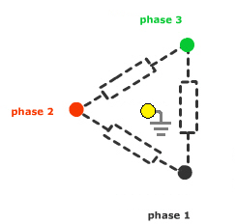
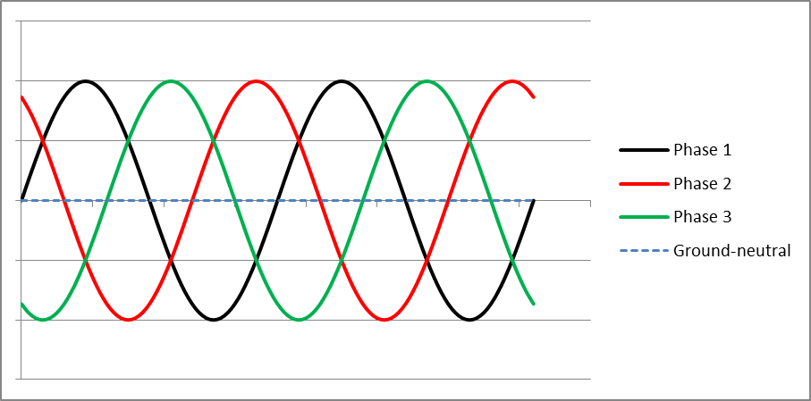
Basics of 3 phase power
Three phase electric power is theoretically a perfectly balanced set of set of sine waves at one frequency
  The three voltages in the system always cancels out to zero voltage on the neutral.
If the system is totally perfect, active grounding of the neutral is unnecessary because the voltage of the neutral point is always canceled out, and current can’t flow.

Slide 4
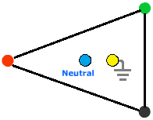
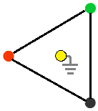
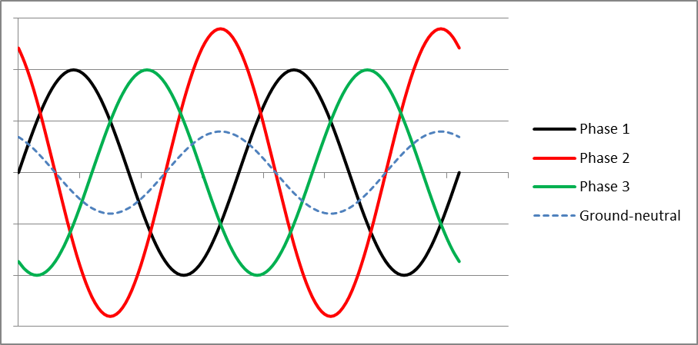
Power imbalance
What happens if one phase has a different voltage?
If the power isn’t perfectly balanced, then we can re-draw the diagram with one of the phases (Phase 2 in this example) having a higher magnitude than the rest. This moves the Neutral point away from the Earth point and creates a net voltage, because the three phases are imbalanced and don’t cancel out anymore.
But this isn’t stable – electric power is a sine wave
  So the net ground-neutral (G-N) voltage is also a sine wave
    (In this simple example)
Ground to neutral voltage
Note: Voltage sags or surges are just extreme cases of power imbalances

Slide 5
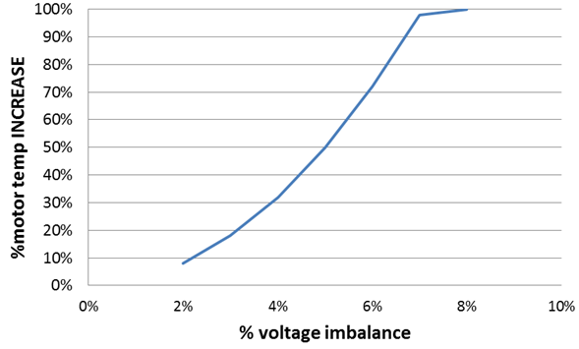
Power imbalance
Impact on equipment
All three-phase equipment (motors, pumps, transformers, compressors, etc) will start to run hotter because of the power imbalance
  One example shows that as little as a 7% imbalance can double the operating temperature of a motor
Why is this important?
  Hotter equipment dies sooner
    Heat breaks down the electrical insulation and causes premature arcing and other failures
  Hotter equipment doesn’t run as efficiently
  Hotter compressor motors are harder to cool down
    This will have the same effect on the cooling capacity of the refrigeration system as having chilled water that is too warm
Compressors are very sensitive to power imbalances
  A phase imbalance in the power going to the coldhead will impact the smooth flow of the displacer and interrupt the compression/counter-flow action, decreasing the cooling capacity
  An imbalance of more than approximately 10% can cause the coldhead motor to stop operating

Slide 6
Power imbalance
What you see in the reports
The shape of the power waveforms can indicate that the ground-to-neutral connections are not good enough to support the full voltage
  These will create additional harmonics (see next slide)
Note: IEC 61000-4-27 (international regulation) allows a maximum of 2% for power imbalance

Slide 7
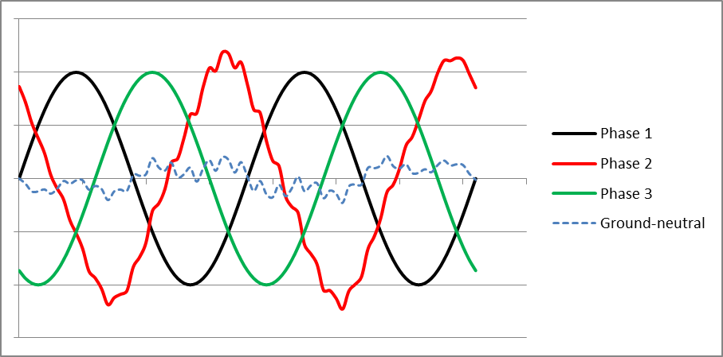
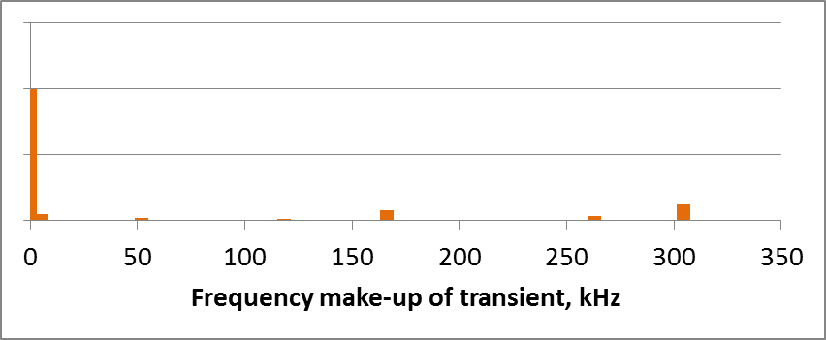
Harmonics
Most real-life power isn’t transmitted in perfect sine waves
This example showing some noise on Phase 2, but it looks pretty good, right?
  We can break the G-N voltage signal into a set of component sine waves all at different frequencies
    We see that there is a large component wave of noise at approximately 300kHz
The sharper the G-N voltage appears, the higher the frequency of its component waves
Which means:
RF voltage on the grounds and wire shields

Slide 8
Harmonics
What you see in the reports
Harmonics are typically reported as multiples of the primary frequency
  For example, Harmonic “4” would be 200Hz if the incoming power is 50Hz, but 240Hz if the incoming power is 60Hz
Total Harmonic Distortion (THD) is reported in percent
  This is the total percentage of your voltage that is made up of component waves that are at harmonic frequencies
  Per IEEE-519 standard, this must be less than 3%

Slide 9
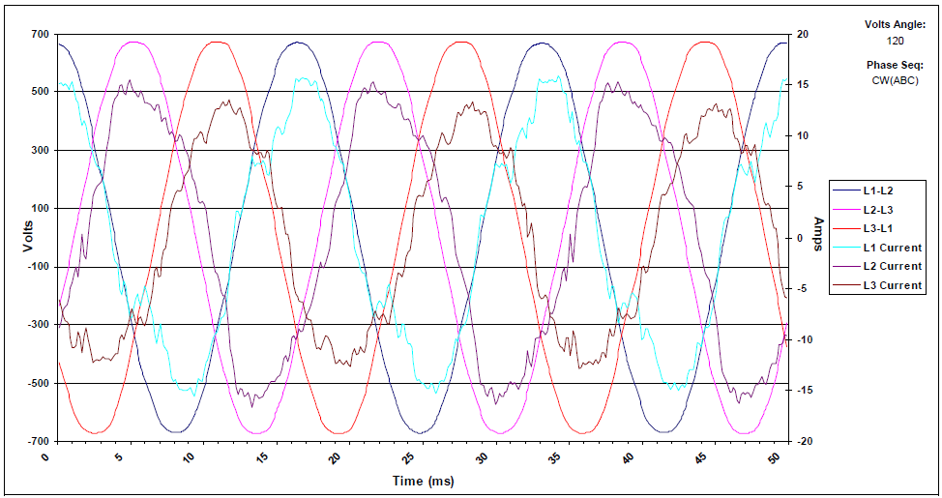
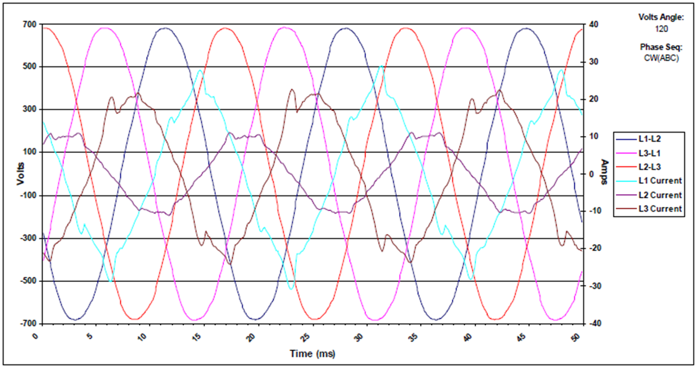
What is our system baseline?
Normal Operation power in an Achieva system, LCC1
Normal Operation power in an Ingenia system, LCC2b

Slide 10
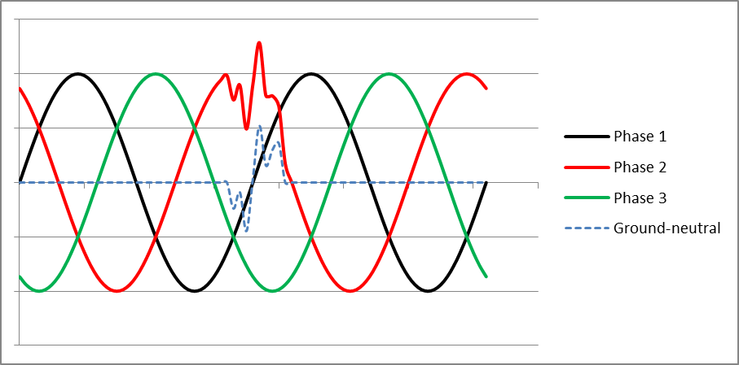
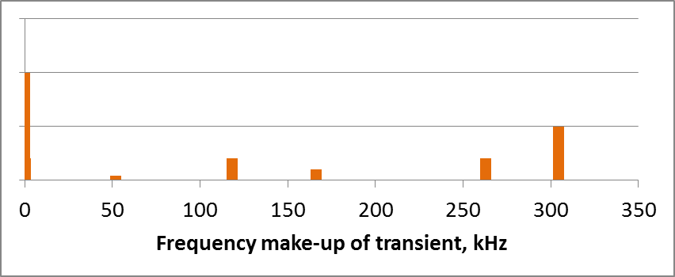
Transients
Transients are very short duration problems
They can seem like a performance improvement, because the voltage is so good for most of the time
BUT
  When we break the G-N voltage signal into its component waves, there is a much LARGER signal at approximately 300kHz
Short duration transients can have high magnitude and high frequency RF
  Frequencies in the MHz range are not uncommon
Which means:
RF voltage on the grounds and wire shields

Slide 11
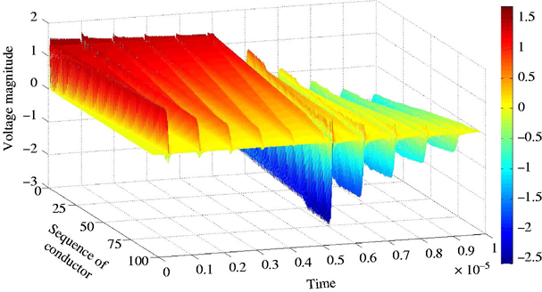
Transients
What you see in the reports
Impulses
  Short duration, high magnitude voltages – this will have significant harmonic content
    Can cause insulation breakdown, failures in motors & solid state components, shorting across the backplane
    Will cause RF
  Transient amplification
    In the very short term (less than 10 milliseconds) the voltage of the transient can become much higher than the initial voltage impulse in a system with high inductance and capacitance
    Short term voltages of up to 3 or 5 times the input are not uncommon

Slide 12
Ground loops
Changing magnetic field through a closed loop can create current in the loop
  If you have current in the loop, you will also have a voltage
    (All cables have resistance, and the voltage is the current multiplied by the resistance)
The voltage created by the ground loop will have the same frequency as the magnetic field that created it
  If the magnetic field is created from the RF cables and wires that are part of the MRI system, the voltage on the ground loop will be an RF voltage
Which means:
RF voltage on the grounds and wire shields
Click here for
Physics
Fundamentals

Slide 13
Ground loops, it DOES get worse
Electric “waves” – the voltage moving down the wire – will reflect off of any termination (connector, solder joint, sharp bend, etc.)
  At the reflection point, the wave can:
    Reflect completely
      Actual voltage is doubled
    Reflect partially
      Actual voltage is increased
      Can get additional high frequency harmonics
    Not reflect at all
      Actual voltage is same
  The higher the frequency of the voltage wave, the easier it reflects, and the more RF voltage you will see
  What you get depends on how large your loop is, what the resistance is, how tight the connectors are screwed down, etc.
Differential Mode:
If this gets bad enough, the ground signal on one side of the loop starts flowing in the opposite direction. You can even get a current on the ground loop that flows around and around so that Any signals that are referenced to ground (like the DPS) can appear to be backwards.

Slide 14
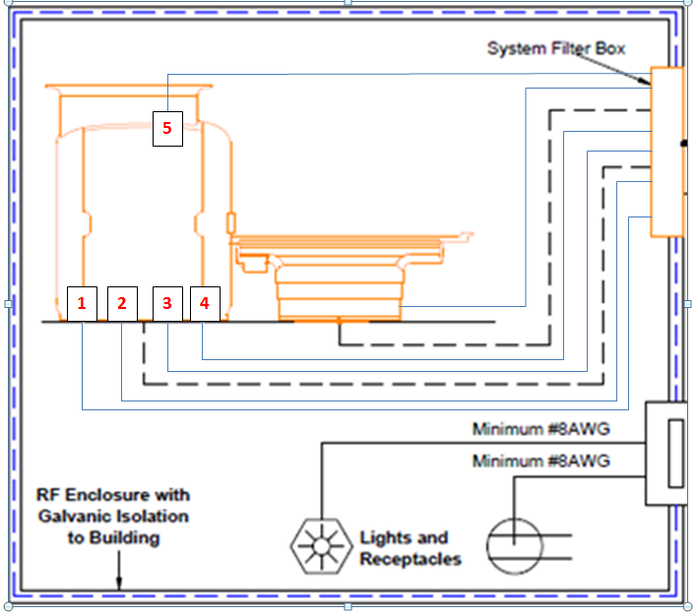
Designed-in ground loops
The scan room is full of ground loops. There are many connections between the magnet and the wall (RF cables, fibers, PFEI cables, RF cables, etc.)
Power cable with its own earth wire
Shielded signal cables
Shielded signal cables
Neutral gradient cable
Helium lines
This is carefully designed. Any extra or missing wires can change everything!
WHY?
Unshielded cables were capacitively connected to the MIB and caused the PCS to quench
  To break the capacitor, we created a loop with the shielded cables
    All the wires are routed relatively closely together
    Therefore: limit the area of the loop
    Therefore: magnetic field inside the loop will be smaller
    Therefore: voltage created will be smaller

Slide 15
Power outages
Power outages result in compressor and chilled water outages
  Thermal shields warm up
  Chilled water warms up
    Compressor might not be operating at peak efficiency for a significant time afterwards
Power outages can also cause any of the power quality issues mentioned above
  Loss of one phase can cause significant power imbalance
  Switching transients as the utility tries to contain the power outage can cause significant harmonics and transients
    Transients can be generated in the electric grid and propagate into the site
    Transients can be generated by the stored energy in our equipment reacting to ground loops, external conditions, etc.

Slide 16
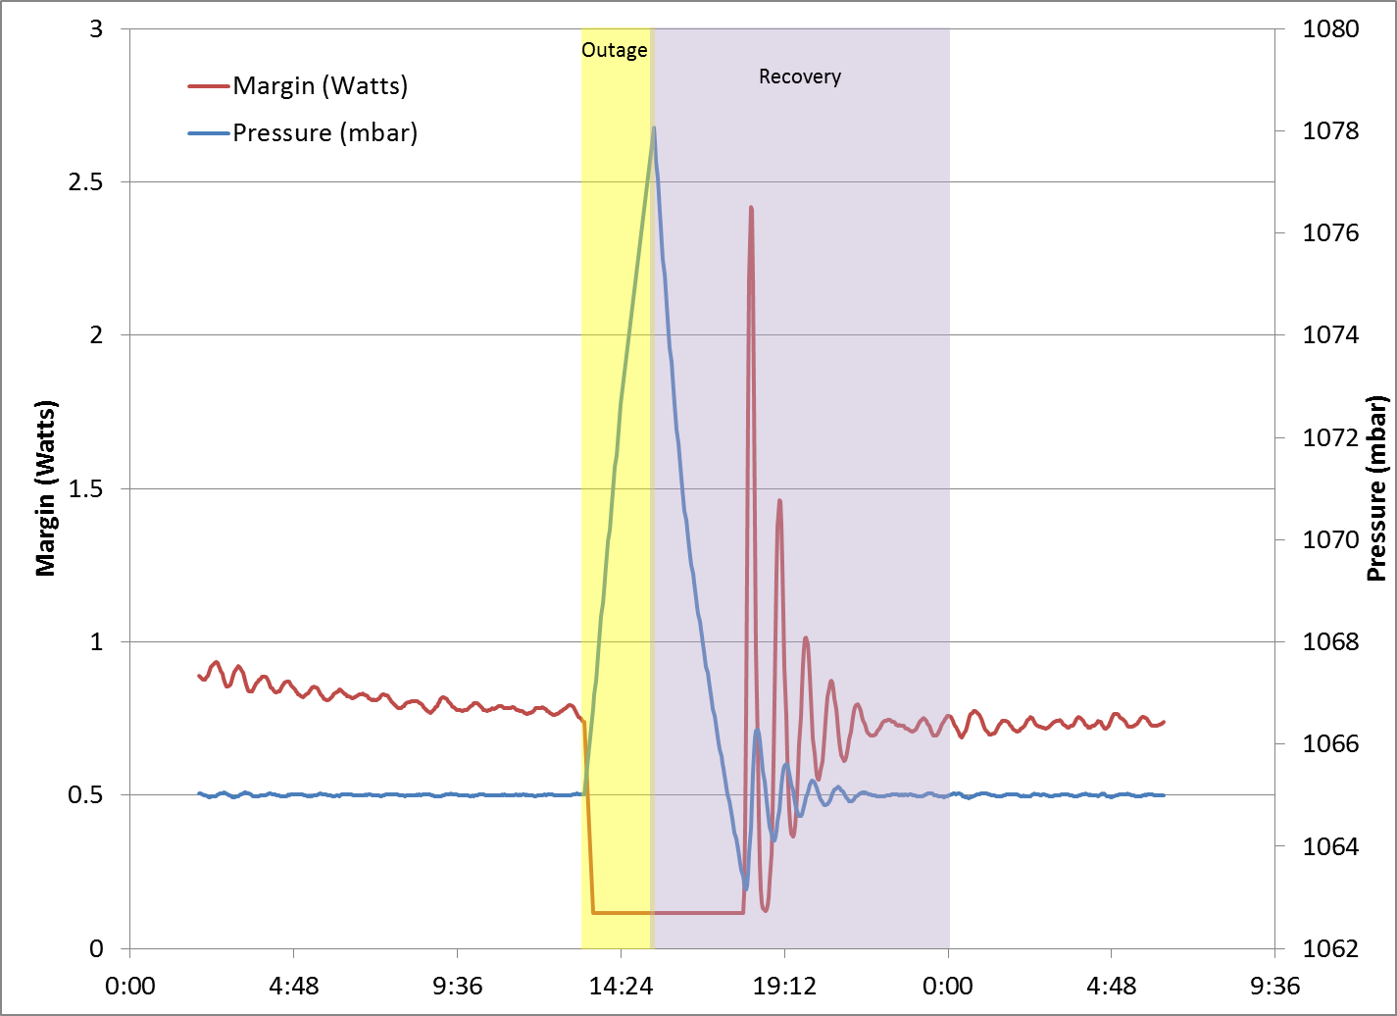
Power outages
Recovery from power outages can be worse than recovery from compressor outages if the chilled water also heats up
What you see in the data
Thermal shields warm up
  Recovery time can be significantly longer than the duration of the outage
    This example the magnet took 9 hours to recover from a
    2-hour outage
    Recovery is expected to take 4-6 times as long as the duration of the outage
  The magnet is more sensitive to quench initiators even after recovery
    Notice minor margin and pressure instabilities continuing for another 8 hours in this example

Slide 17
Main results of poor power quality/grounding
Image Quality, Parts Consumption…
Image Quality
  With all that RF flying around, it is easy to understand how power quality and grounding issues can impact image quality, create artifacts, etc.
  Applications personnel can spend days trying to track down an error that turns out to be bad wiring
Parts consumption, real
  As mentioned, hot parts die sooner
  Sensitive circuit boards can short out from the transients or high frequency harmonics
  Amplifiers and other solid-state equipment fail due to power sags/surges and imbalances
Parts consumption, troubleshooting
  Many signals in the system are “ground referenced” – their signals are interpreted based on the assumption that there is zero ground voltage. If the ground voltage is not zero, then the signal could appear to be wrong
    This results in swapping out many properly functioning parts to try to find the source of the error

Slide 18
You only need a few milliAmps of current to start a magnet quench
Main results of poor power quality/grounding
…Quenching
Quenching
  The power/grounding can create situations that are already known to be quench initiators:
    RF noise
    Reduced cooling
  Additional quench initiators that result from power/grounding problems:
    PCS malfunction
      Both the MPCS and the QPCS are ground referenced
        One side of the switch is connected to ground and the other is connected to the magnet coils
        The coils are highly inductive => they do NOT change current quickly
          High frequency transients will flow through the PCSs
        A high frequency transient/harmonic on the grounds can cause current to flow through the PCS
    Capacitive discharge
      The magnet and cryostat act as a very large capacitor
        A voltage increase on one side of the capacitor (the “grounded” cryostat) can cause a trickle current to flow through to the other side (the magnet)
        The current will create heat, which can cause the magnet to quench

Slide 19
You only need a few milliAmps of current to start a magnet quench
… Quenching, continued
(the major results of poor power quality/bad grounding
Quenching
    AC losses
      Superconductors do NOT like to change voltage
        If a high frequency voltage transient enters the superconducting coils, the energy needed to change the voltage will lead to heat being generated right on the superconductor
        The amount of heat generated is based on the frequency of the voltage (higher frequency = more heat) and the strength of the background magnetic field (higher field = a lot more heat)
          The amount of heat increases relative to the strength of the background magnetic field to the third power (i.e., doubling the field strength increases the generated heat 2x2x2=8 times)
          This heat is always worst in the area of highest magnetic field, where the superconductor is most sensitive to quenching

Slide 20
Specifications and Practical Interpretations
The power and grounding of the MRI system is specified as follows:
  Must meet IEC 60601
    International Standard, thousands of pages detailing requirements, best practices, etc.
  Must meet local electrical codes
      NEC, OSHA (America)
      Electricity at Work Regulations (UK)
      …..
    Codes for the country, city, town, village, etc.
      Supplemental/additional to IEC 60601
        Cannot request practices in violation of IEC 60601
  Must meet the requirements in the PRD
    PRD and site plans capture all the specifications for all the parts of the MRI system (including the magnet, amplifiers, compressor, gradient, etc.)
  Must match the prints for UL/CE certified equipment
    Any equipment that has a specific electrical certification must be wired exactly the same as the certification
      No added wires, parts, etc.
      No missing wires, parts, etc.
        Even if there is no logical technical reason

Slide 21
SMI System
Drawings
Earthing Best Practices

Slide 22
Case Studies
Site Name | SRN | Magnet type |  | Fixed | Result
 |  | Achieva 1.5T | Power outages, THD, ground current, etc. | Q1 2014 | 4 Q prior 0 Q after
 |  | Ingenia 1.5T | Significant ground loops, earthing issues | Q1 2014 | 7 Q prior 0 Q after
 |  | Achieva 1.5T | PQS showed excessive ground current surges (2 TC done prior) | Q3 2013 | 4 Q prior 0 Q after
 |  | Achieva 1.5T | Power survey in 2011 said ground problems, not fixed until 2 quenches later | Q2 2013 | 6 Q prior 0 Q after
 |  | Panorama 1.0T | ground cable missing between Cage and Pipe, visual inspection | Q1 2013 | 4 Q prior 1 Q after (No data)
 |  | Achieva 1.5T | Earthing not to spec, visual inspection, 3rd magnet in room | Q1 2013 | 3 Q prior 0 Q after
 |  | Panorama 1.0T | No ground connection from MDE box to MDU box, visual inspection | Q3 2013 | 1 Q prior 0 Q after
 |  | Achieva 1.5T | Power survey 2011 = extremely high THD at 5.3%, poor grounds, not fixed 5 quenches later | Not yet | 7 Q prior
Removed to be certain not to violate any
privacy regulations

Slide 23
Case Studies, con’t
Site Name | SRN | Magnet type |  | Fixed | Result
 |  | Intera 1.5T | >30V G-N | July 2011 | 5 Q prior 0 Q after
 |  | Achieva 1.5T | >33V G-N, found at Q 6, not fixed until 2 quenches later, magnet de-installed, customer unhappy | Q1 2014 | 8 Q prior 1 Q after* (ice from previous Q not removed)
 |  | Achieva 3.0T | One of the grounds from “building steel” was connected to the “wrong” side of the step-down / isolation transformer creating a “loop”. Ground loop caused signal malfunction updating from CSW-71 to F-50. Replaced CDAS backplane, several cables, RMMU twice, compressor twice, FSE on site 3 weeks | July 2013 | 3 Q prior 0 Q after
Note: Case Studies list could continue, but these examples give the highlights
Two KM have implemented PROACTIVE auditing for grounding/power quality after seeing the long term benefits

Slide 24
Proof it works….
Peak current is almost 15 Amps,
sharp transients
Repaired ground with proper size conductor.
Ground current reduced to 5 Amps.
Still too high
Peak current drops to 5 Amps,
still sharp transients
Initial report showed excessive ground currents on Ingenia 3.0T
Peak current less than 2 Amps,
no sharp transients
This is the report after the system was made to conform to the Philips ground plans. The ground current is reduced and has no wave shapes while the system is scanning.

Slide 26
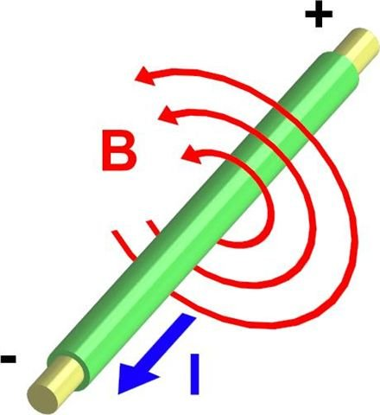
Moving Charges and Magnetic Fields
Basic Idea: Moving charged particles such as electrons or protons generate a magnetic field when in motion.
In electricity, the current is the flow of charged particles. Therefore the current creates a magnetic field. Magnetic fields are denoted by the letter B.
An example of a magnetic field created by current.
Physics
Fundamentals

Slide 27
Faraday’s Law of Induction
Faraday’s Law of Induction states that a time-varying magnetic
field, B(t), which passes through a closed loop will produce an electromotive force (EMF), which in turn creates a current, I.
B(t)
B(t)
B(t)
Current I
The magnetic field passes through the closed loop, inducing a current.
The magnetic field does NOT pass through the loop, and no current is induced.
The magnetic field passes through an OPEN loop, and no current is induced.
Physics
Fundamentals

Slide 28
Ground Loops
A ground loop occurs when two circuits are connected at a point where the difference in potential is expected to be zero, but isn’t actually zero. This results in unwanted currents that can generate interference or affect equipment performance.
Interconnecting cable
Device A
Device B
B(t)
Ground Cable with resistance R2
Ground Cable with resistance R1
Junction Point
Above is an example of a ground loop. The magnetic field B(t) generates a current in the wires.
Physics
Fundamentals

